Slide 1
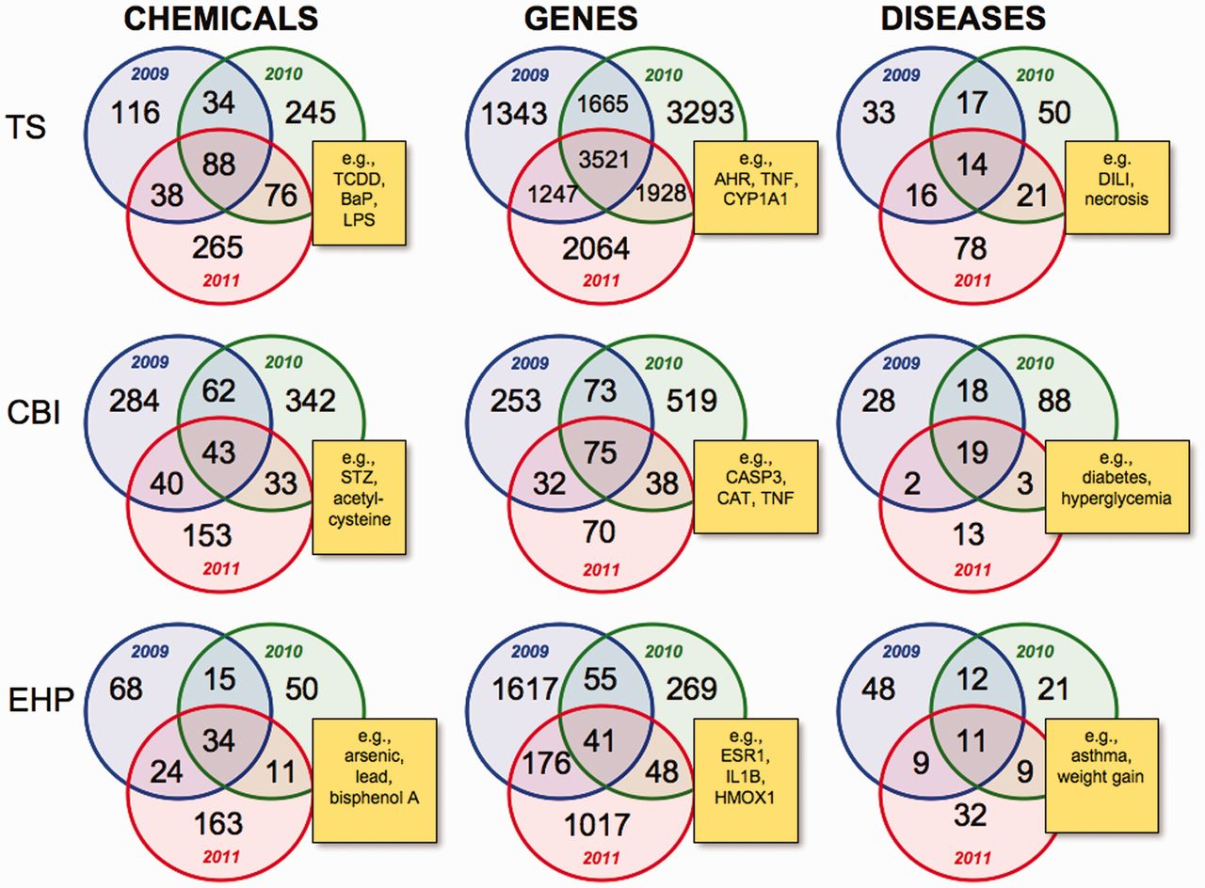
Figure 2 Intra-journal data comparison for 2009–11. Nine Venn diagrams depict the overlapping datasets for the number ...
Notes:
Figure 2 Intra-journal data comparison for 2009–11. Nine Venn diagrams depict the overlapping datasets for the number of chemicals, genes and diseases for each journal for publication years 2009 (blue circles), 2010 (green circles) and 2011 (red circles). Yellow boxes provide examples of shared elements for all 3 years in the centre intersection of each Venn diagram and are described in the main text. TS = Toxicological Sciences, CBI = Chemico-Biological Interactions and EHP = Environmental Health Perspectives. All data are provided in the Supplementary Data, and readers can use CTD’s ‘MyVenn’ tool (http://ctdbase.org/tools/myVenn.go) to re-draw the Venn diagrams to explore all the sets.
Unless provided in the caption above, the following copyright applies to the content of this slide: © The Author(s) 2012. Published by Oxford University Press.This is an Open Access article distributed under the terms of the Creative Commons Attribution License (http://creativecommons.org/licenses/by-nc/3.0/), which permits non-commercial reuse, distribution, and reproduction in any medium, provided the original work is properly cited. For commercial re-use, please contact journals.permissions@oup.com.

