Slide 1
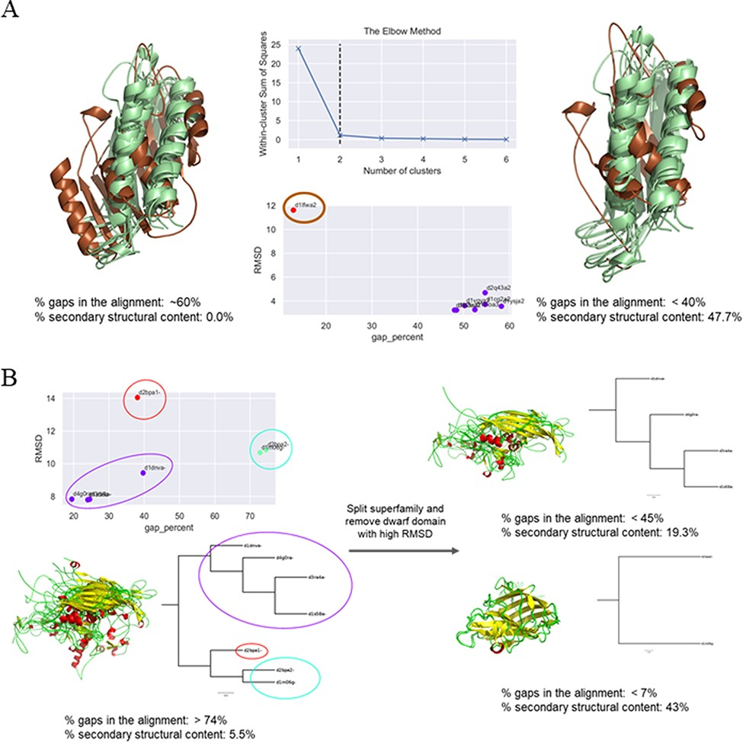
Figure 3. Examples of clustering method-based improvement of alignment. (A) For the superfamily bacterial exopeptidase ...
Notes:
Figure 3. Examples of clustering method-based improvement of alignment. (A) For the superfamily bacterial exopeptidase dimerization domain (SCOPe ID 55031), the domain d1lfwa2 (brown) was found to be a giant member, which had RMSD >10 Å to other members and this led to a large number of gaps in the alignment. The overhang region of this domain was trimmed and the members realigned. This significantly improved the secondary structural conservation of the alignment and reduced the number of gaps. (B) Three clusters were predicted for the MMS ssDNA viruses (88645), and the alignment was found to be highly ‘gappy’ (>70% gaps). The MMS was split into two, and a dwarf domain that was the lone member of the third cluster was removed to obtain an improved alignment with a significantly lesser number of gaps in alignment of each split MMS and higher secondary structural conservation.
Unless provided in the caption above, the following copyright applies to the content of this slide: © The Author(s) 2022. Published by Oxford University Press.This is an Open Access article distributed under the terms of the Creative Commons Attribution License (https://creativecommons.org/licenses/by/4.0/), which permits unrestricted reuse, distribution, and reproduction in any medium, provided the original work is properly cited.

