Slide 1
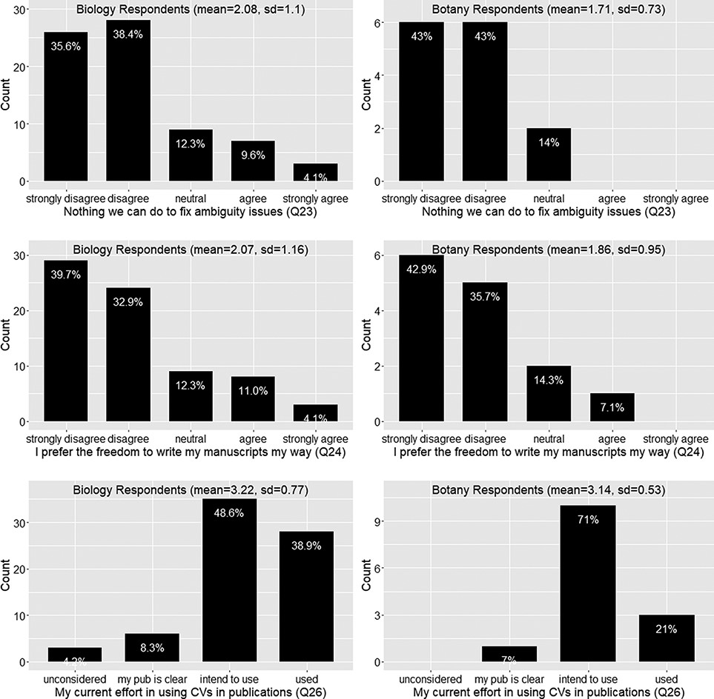
Figure 11. Ambiguity issue cannot be solved (Q23), preference for the freedom to write manuscript own way (Q24) and ...
Notes:
Figure 11. Ambiguity issue cannot be solved (Q23), preference for the freedom to write manuscript own way (Q24) and current effort in using controlled vocabularies in publications (Q26).
Unless provided in the caption above, the following copyright applies to the content of this slide: © The Author(s) 2022. Published by Oxford University Press.This is an Open Access article distributed under the terms of the Creative Commons Attribution License (https://creativecommons.org/licenses/by/4.0/), which permits unrestricted reuse, distribution, and reproduction in any medium, provided the original work is properly cited.

