Slide 1
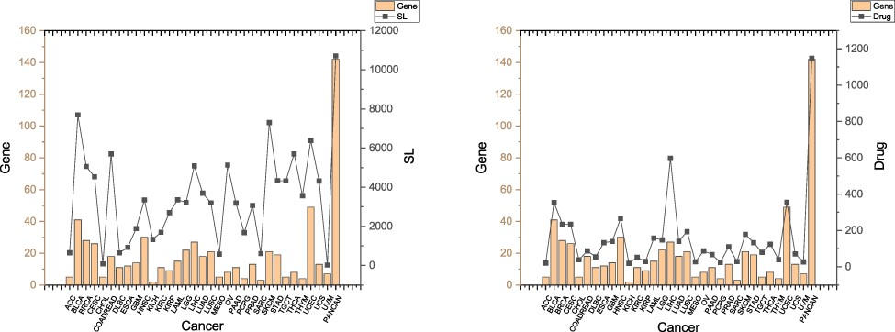
Figure 2. SLs and drugs in SynLethKG for driver genes of 32 cancers and pan-caner. The bar chart shows the numbers of ...
Notes:
Figure 2. SLs and drugs in SynLethKG for driver genes of 32 cancers and pan-caner. The bar chart shows the numbers of cancer driver genes in SynLethKG. In the left figure, the line chart represents the numbers of SLs containing the cancer driver genes in SynLethKG, and in the right figure, the line chart represents the numbers of drugs associated with the driver genes in SynLethKG.
Unless provided in the caption above, the following copyright applies to the content of this slide: © The Author(s) 2022. Published by Oxford University Press.This is an Open Access article distributed under the terms of the Creative Commons Attribution-NonCommercial License (https://creativecommons.org/licenses/by-nc/4.0/), which permits non-commercial re-use, distribution, and reproduction in any medium, provided the original work is properly cited. For commercial re-use, please contact journals.permissions@oup.com

