Slide 1
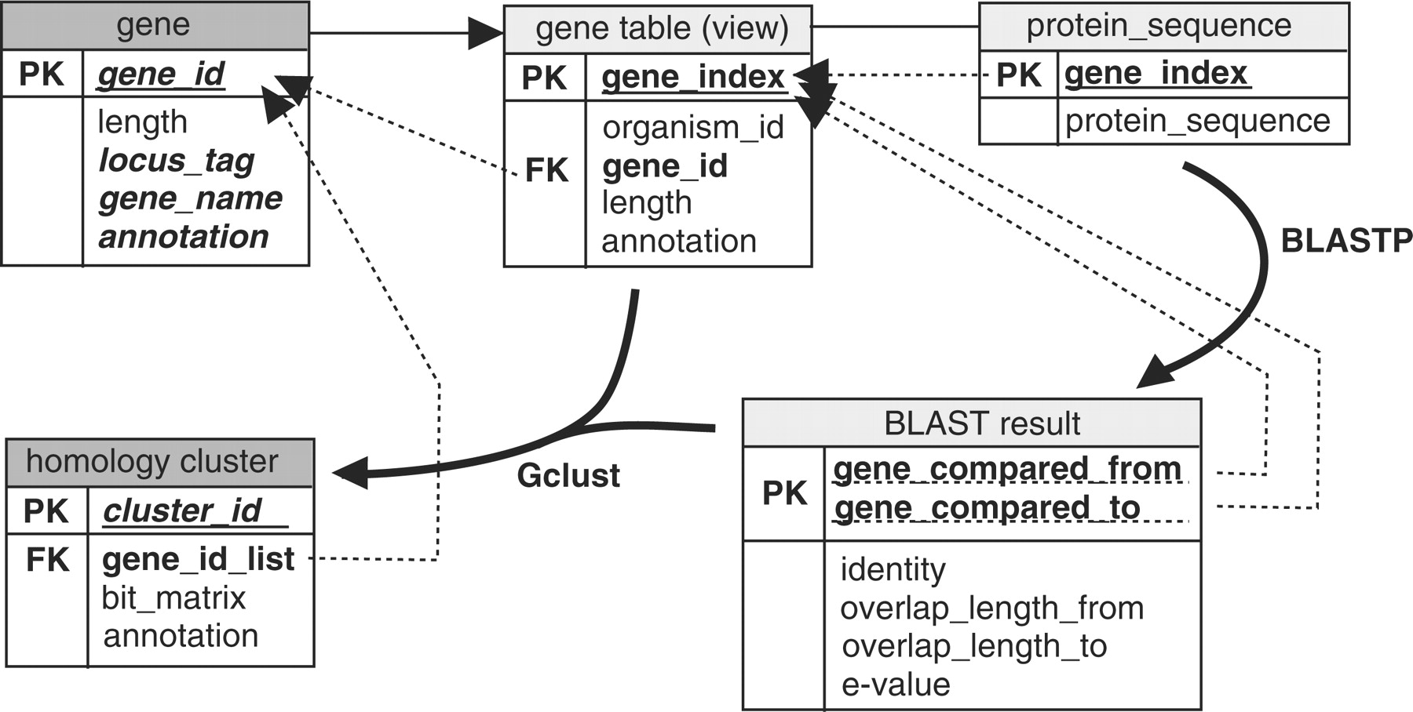
Figure 1. The process of database construction. Each box represents a conceptual object representing the structure of ...
Notes:
Figure 1. The process of database construction. Each box represents a conceptual object representing the structure of data. The topmost line in each box shows the name of the relational table. PK, primary key; FK, foreign key. Each dotted arrow indicates the relation of an entity to the reference. Bold arched arrows indicate an external operation to produce the relations (the main program names are given near the arrows). Light gray background of the title, transaction (temporary and internal) relation; dark gray background, resulting relation.
Unless provided in the caption above, the following copyright applies to the content of this slide: © The Author(s) 2010. Published by Oxford University Press.This is Open Access article distributed under the terms of the Creative Commons Attribution Non-Commercial License (http://creativecommons.org/licenses/by-nc/2.5), which permits unrestricted non-commercial use, distribution, and reproduction in any medium, provided the original work is properly cited.

Slide 2
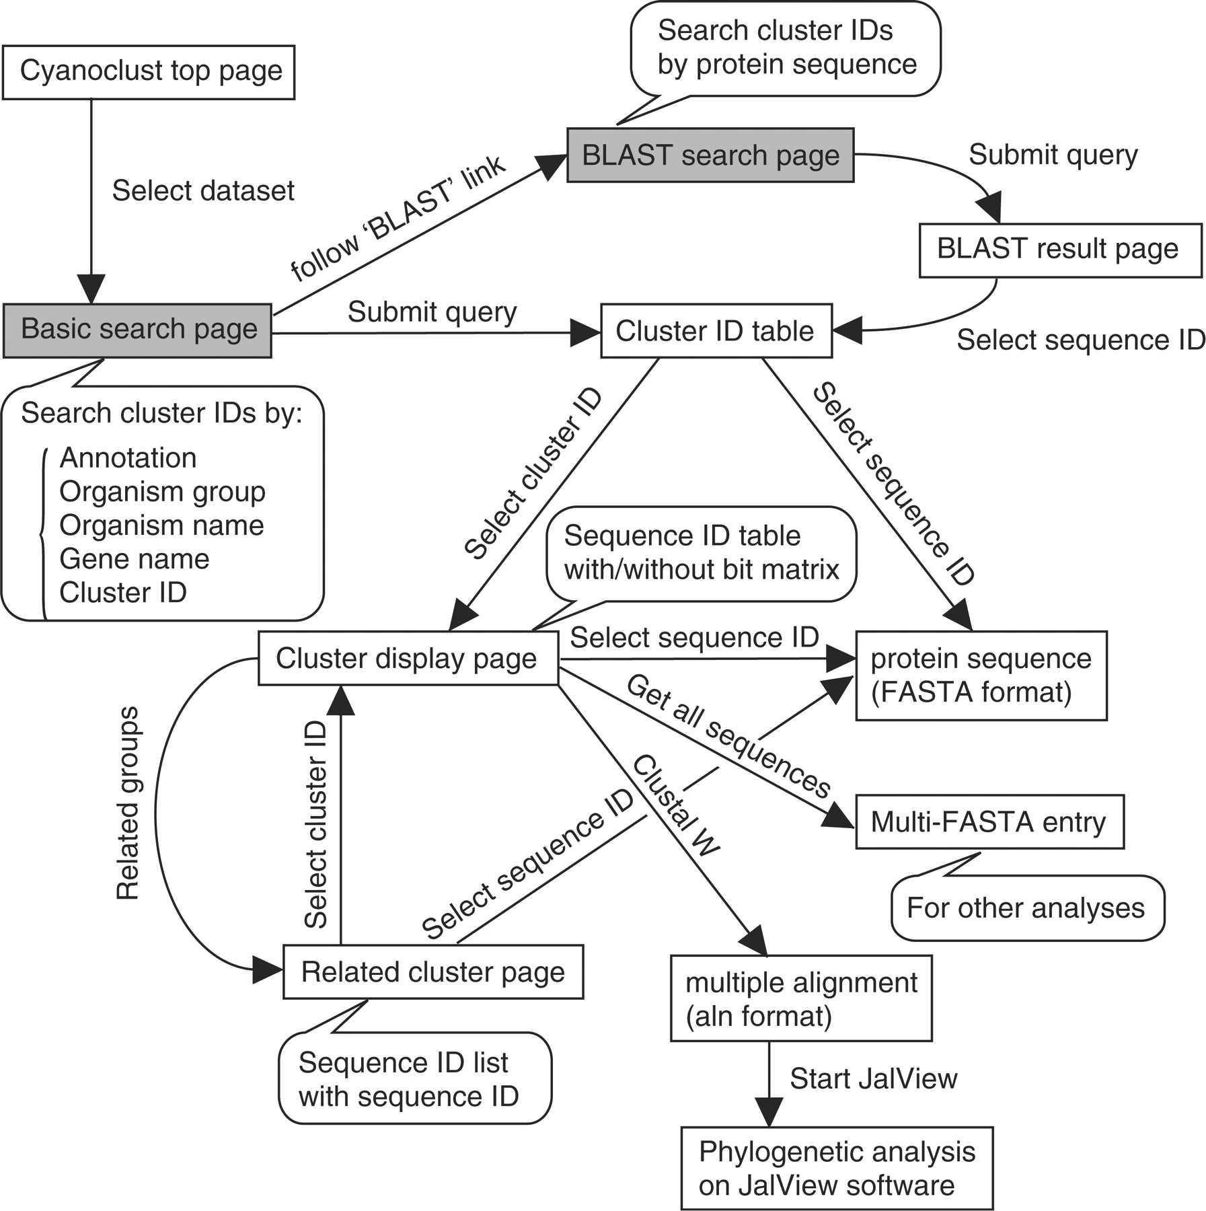
Figure 2. Page transition diagram of the CyanoClust web interface. Each box indicates a web page, and each arrow ...
Notes:
Figure 2. Page transition diagram of the CyanoClust web interface. Each box indicates a web page, and each arrow indicates the page transition caused by an action. Each balloon indicates a simplified explanation of the indicated page. The gray boxes indicate the two types of initial search page, which are also linked with each other.
Unless provided in the caption above, the following copyright applies to the content of this slide: © The Author(s) 2010. Published by Oxford University Press.This is Open Access article distributed under the terms of the Creative Commons Attribution Non-Commercial License (http://creativecommons.org/licenses/by-nc/2.5), which permits unrestricted non-commercial use, distribution, and reproduction in any medium, provided the original work is properly cited.

Slide 3
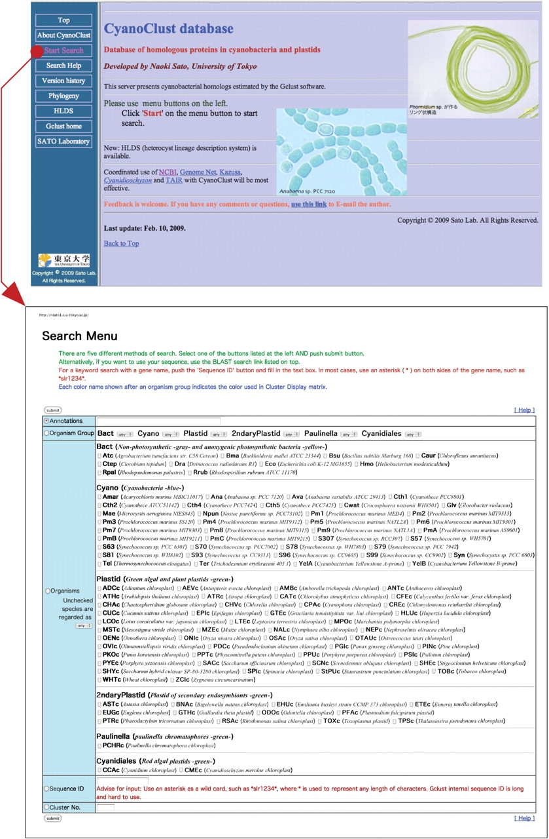
Figure 3. Screen shots showing the top page and Basic Search page. The Basic Search page opens upon following the link ...
Notes:
Figure 3. Screen shots showing the top page and Basic Search page. The Basic Search page opens upon following the link in the top page, as indicated by an arrow. The ‘Basic Search’ page accepts a search query consisting of an individual gene name or annotations, gene conservation in specified organism groups or species, or just the cluster ID. By submitting a query, a cluster ID table is displayed under the name ‘Search Result’.
Unless provided in the caption above, the following copyright applies to the content of this slide: © The Author(s) 2010. Published by Oxford University Press.This is Open Access article distributed under the terms of the Creative Commons Attribution Non-Commercial License (http://creativecommons.org/licenses/by-nc/2.5), which permits unrestricted non-commercial use, distribution, and reproduction in any medium, provided the original work is properly cited.

Slide 4
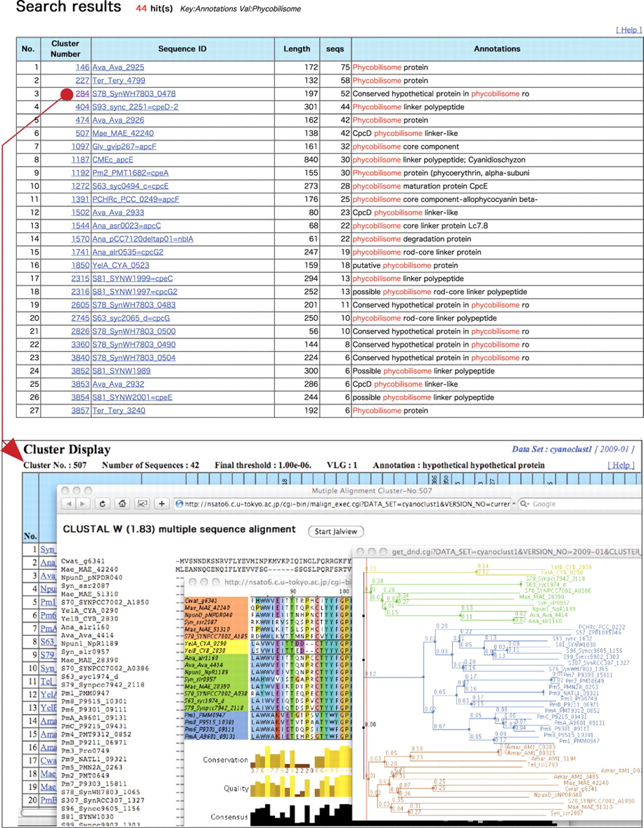
Figure 4. Example analysis of a cluster. The upper figure shows a cluster ID table in a ‘Search Results’ page. Upon ...
Notes:
Figure 4. Example analysis of a cluster. The upper figure shows a cluster ID table in a ‘Search Results’ page. Upon clicking the cluster number in the cluster ID table (red circle), a ‘Cluster Display’ page is shown. Below is a stacked view of a ‘Cluster Display’ page, a multiple alignment, and a dendrogram driven by the program Jalview. In the ‘Cluster Display’ page, a bit matrix is used to show the similarity of homologs for small clusters (hidden behind other windows in this example), but only a list is shown if the cluster size is large.
Unless provided in the caption above, the following copyright applies to the content of this slide: © The Author(s) 2010. Published by Oxford University Press.This is Open Access article distributed under the terms of the Creative Commons Attribution Non-Commercial License (http://creativecommons.org/licenses/by-nc/2.5), which permits unrestricted non-commercial use, distribution, and reproduction in any medium, provided the original work is properly cited.

