Slide 1
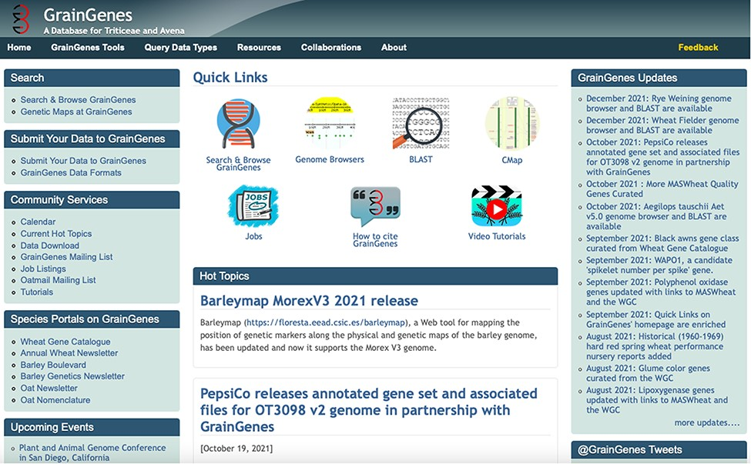
Figure 1. The GrainGenes’ homepage (https://wheat.pw.usda.gov) shows a wide range of services and jump points available ...
Notes:
Figure 1. The GrainGenes’ homepage (https://wheat.pw.usda.gov) shows a wide range of services and jump points available through an intuitive, graphic interface. The top menu buttons open up new links.
Unless provided in the caption above, the following copyright applies to the content of this slide: © Her Majesty the Queen in Right of Canada, as represented by the Minister of Agriculture and Agri-Food Canada, 2022. Elements of this work were written by an US Government Employee and the work is public domain in the US. Published by Oxford University Press 2022.This work is written by (a) US Government employee(s) and is in the public domain in the US.

