Slide 1
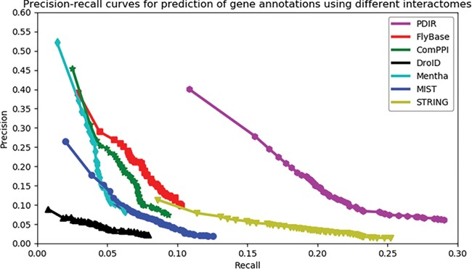
Figure 2 Assessment of the capabilities of seven interactomes to group functionally associated genes together. The ...
Notes:
Figure 2 Assessment of the capabilities of seven interactomes to group functionally associated genes together. The precision-recall curves of gene function prediction using different interactomes are illustrated. Precision estimates the proportion of correct annotations identified by an interactome. Recall estimates the proportion of new annotations that is identified by an interactome.
Unless provided in the caption above, the following copyright applies to the content of this slide: © The Author(s) 2020. Published by Oxford University Press.This article is published and distributed under the terms of the Oxford University Press, Standard Journals Publication Model (https://academic.oup.com/journals/pages/open_access/funder_policies/chorus/standard_publication_model)

