Slide 1
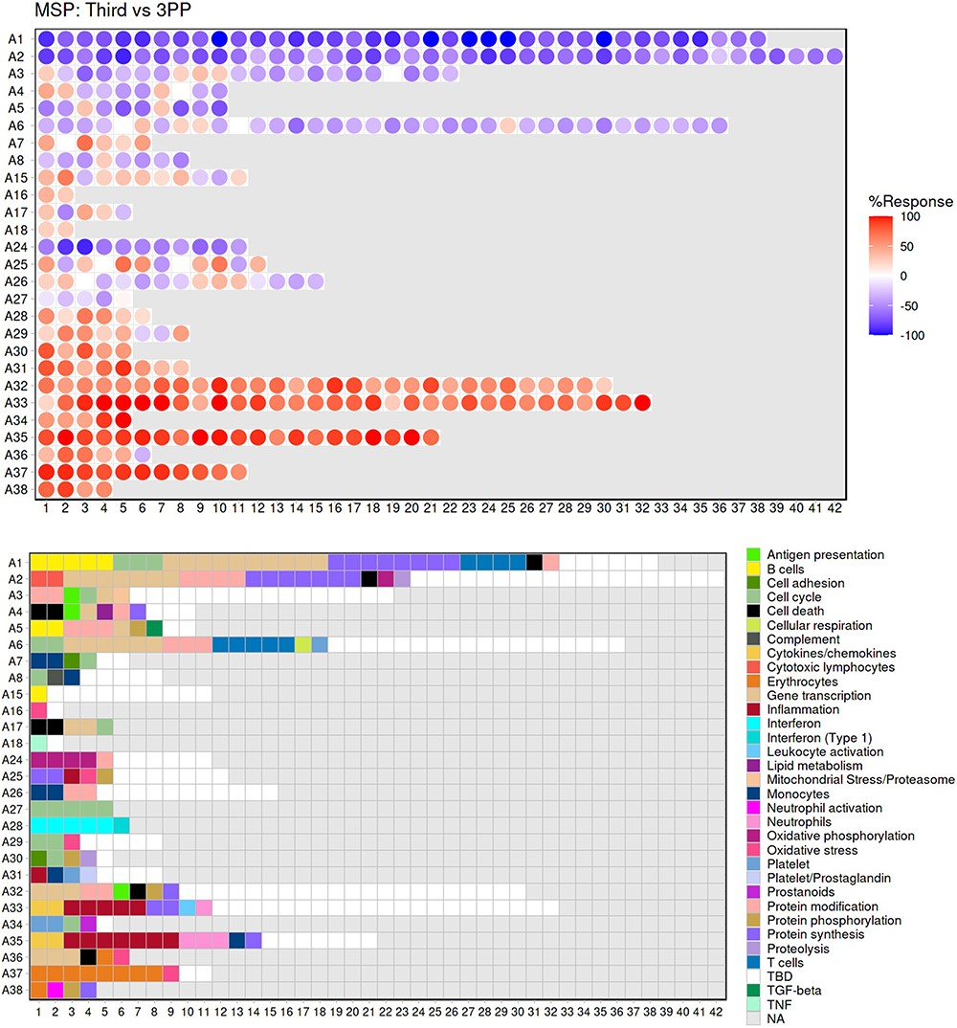
Figure 2. Fingerprint grid plot representation. This fingerprint grid plot represents changes in blood transcript ...
Notes:
Figure 2. Fingerprint grid plot representation. This fingerprint grid plot represents changes in blood transcript abundance in samples collected during the third trimester of pregnancy (‘Third’) from women recruited in the MSP study, relative to transcript abundance in samples collected from the same donors 3 months after delivery (‘3PP’ = 3 months post-partum). The position of the modules on the grid is fixed, with each row regrouping modules from the same ‘module aggregate’, labeled as A1, A2, A3, etc., for Aggregate 1, Aggregate 2, Aggregate 3, etc. Only the 28 aggregates which were assigned more than one modules are represented on this grid (15). Changes in abundance are represented on the grid by a red spot, indicating that constitutive transcripts of the corresponding module are significantly increased in third trimester samples over post-partum samples. A blue spot shows conversely that its constitutive transcripts are significantly decreased. The color gradation is indicative of the ‘module activity’, which is the proportion of transcripts meeting the statistical cutoff that is employed for this comparison—i.e. P < 0.05 and a False Discovery Rate = 0.1, with values for red spots ranging from +15% to +100% (all constitutive transcripts showing a significant increase in abundance) and for blue spots from −15% to −100% (all constitutive transcripts showing a significant decrease in abundance). Finally, the grid below indicates the functional annotations assigned to the modules at their given position using a color code. Areas on the grid in white are for modules for which we could not find clear functional associations (TBD = To Be Determined). Areas on the grid in gray are not assigned to any given modules (NA = Not Applicable).
Unless provided in the caption above, the following copyright applies to the content of this slide: © The Author(s) 2024. Published by Oxford University Press.This is an Open Access article distributed under the terms of the Creative Commons Attribution License (https://creativecommons.org/licenses/by/4.0/), which permits unrestricted reuse, distribution, and reproduction in any medium, provided the original work is properly cited.

