Slide 1
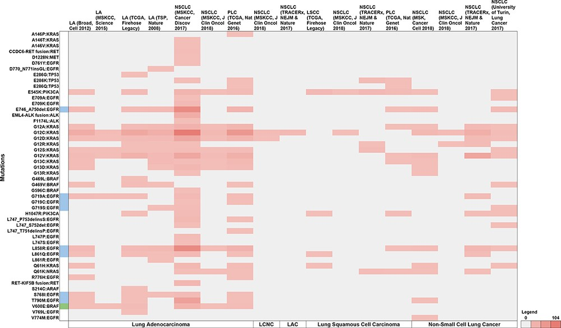
Figure 7. Summary of the breakdown of each of the 50 unique variants across the 11 studies. The variants highlighted in ...
Notes:
Figure 7. Summary of the breakdown of each of the 50 unique variants across the 11 studies. The variants highlighted in blue represent molecules that have been FDA approved, while green represents guidelines as well as FDA approved molecules. Note: LA—Lung adenocarcinoma, NSCLC—non-small cell lung cancer, PLC—pan-lung cancer, LSCC—lung squamous cell carcinoma, LCNC—large cell neuroendocrine carcinoma, LAC—lung adenosquamous carcinoma.
Unless provided in the caption above, the following copyright applies to the content of this slide: © The Author(s) 2021. Published by Oxford University Press.This is an Open Access article distributed under the terms of the Creative Commons Attribution License (http://creativecommons.org/licenses/by/4.0/), which permits unrestricted reuse, distribution, and reproduction in any medium, provided the original work is properly cited.

