Slide 1
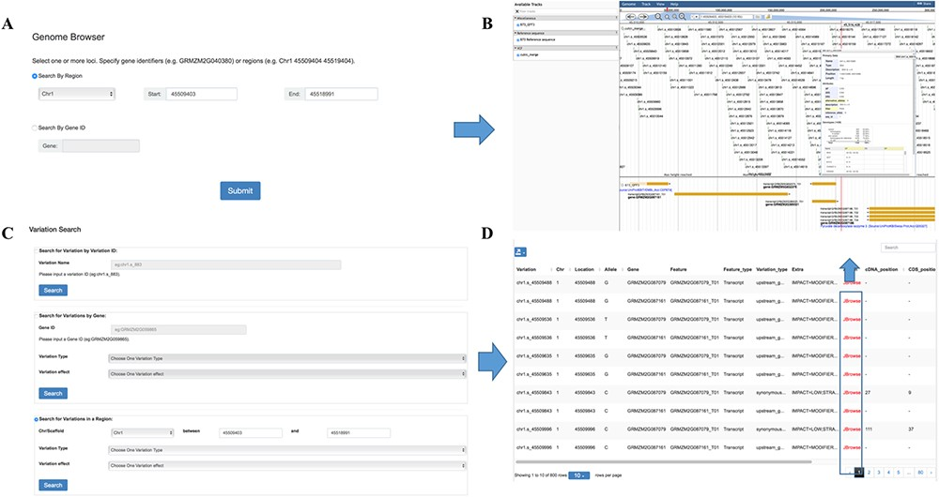
Figure 3 Features of MaizeCUBIC variation module. (A) Variation information of population can be visual browsed by ...
Notes:
Figure 3 Features of MaizeCUBIC variation module. (A) Variation information of population can be visual browsed by searching for chromosome region or gene names in genome browser tool. (B) Schematic of genome browser embedded in MaizeCUBIC, build on JBrowse. (C) Variations can be queried in three ways in variation search tool. (D) The acquired variations would be displayed in the results page within a table and have links to the relevant entry in genome browser tool to see detail information about them.
Unless provided in the caption above, the following copyright applies to the content of this slide: © The Author(s) 2020. Published by Oxford University Press.This is an Open Access article distributed under the terms of the Creative Commons Attribution License (http://creativecommons.org/licenses/by/4.0/), which permits unrestricted reuse, distribution, and reproduction in any medium, provided the original work is properly cited.

