Slide 1
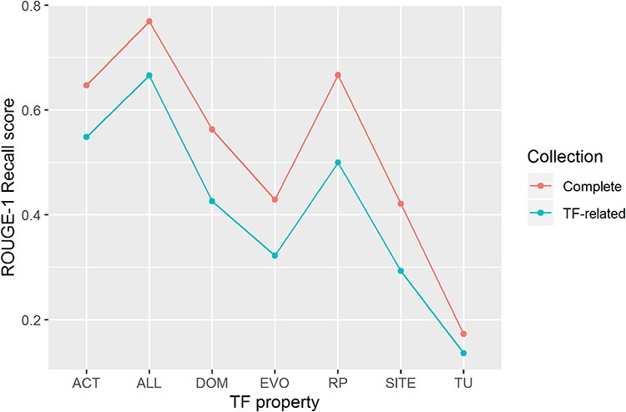
Figure 4. ROUGE-1 recalls scores obtained by automatic summaries without stop words for all properties (ALL) and for ...
Notes:
Figure 4. ROUGE-1 recalls scores obtained by automatic summaries without stop words for all properties (ALL) and for each property. Automatic summaries were created using the complete article collection (Complete) and using only TF-related articles (TF-related).
Unless provided in the caption above, the following copyright applies to the content of this slide: © The Author(s) 2020. Published by Oxford University Press.This is an Open Access article distributed under the terms of the Creative Commons Attribution License (http://creativecommons.org/licenses/by/4.0/), which permits unrestricted reuse, distribution, and reproduction in any medium, provided the original work is properly cited.

