Slide 1
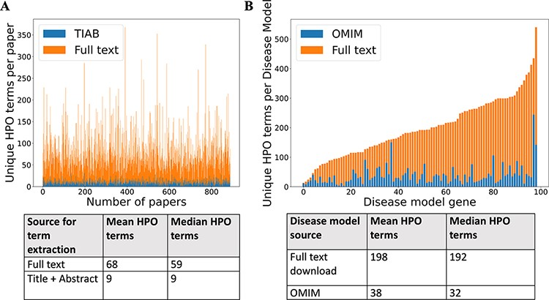
Figure 2. (A) Comparison of number of unique HPO terms extracted from full text vs title + abstract for sample of 962 ...
Notes:
Figure 2. (A) Comparison of number of unique HPO terms extracted from full text vs title + abstract for sample of 962 papers, using full-text download pipeline. (B) Comparison of number of unique HPO terms in disease models generated by full-text download pipeline vs manually curated models in OMIM, for a sample of 99 diseases.
Unless provided in the caption above, the following copyright applies to the content of this slide: © The Author(s) 2022. Published by Oxford University Press.This is an Open Access article distributed under the terms of the Creative Commons Attribution-NonCommercial License (https://creativecommons.org/licenses/by-nc/4.0/), which permits non-commercial re-use, distribution, and reproduction in any medium, provided the original work is properly cited. For commercial re-use, please contact journals.permissions@oup.com

