Slide 1
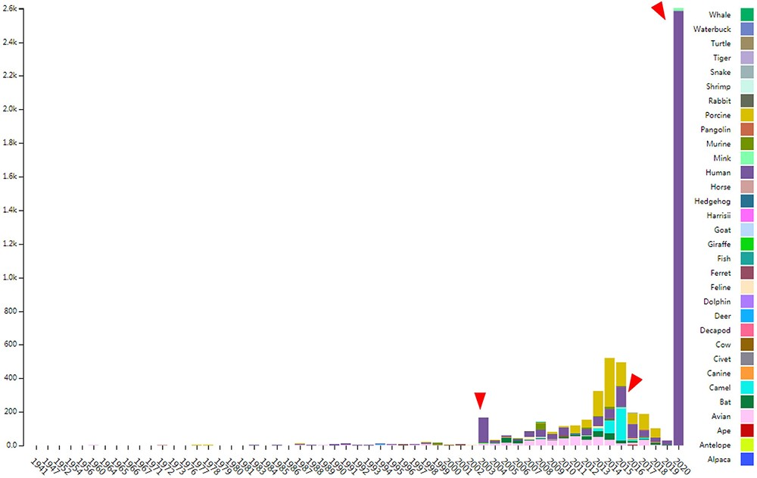
Figure 1. The distribution of documented coronavirus strains in CoVdb according to collection date (X-axis) and hosts ...
Notes:
Figure 1. The distribution of documented coronavirus strains in CoVdb according to collection date (X-axis) and hosts (colored by different colors). Y is the number of coronavirus isolated from some organism. Red triangles points to peaks in the distribution of human coronavirus in years.
Unless provided in the caption above, the following copyright applies to the content of this slide: © The Author(s) 2020. Published by Oxford University Press.This is an Open Access article distributed under the terms of the Creative Commons Attribution License (http://creativecommons.org/licenses/by/4.0/), which permits unrestricted reuse, distribution, and reproduction in any medium, provided the original work is properly cited.

Slide 2
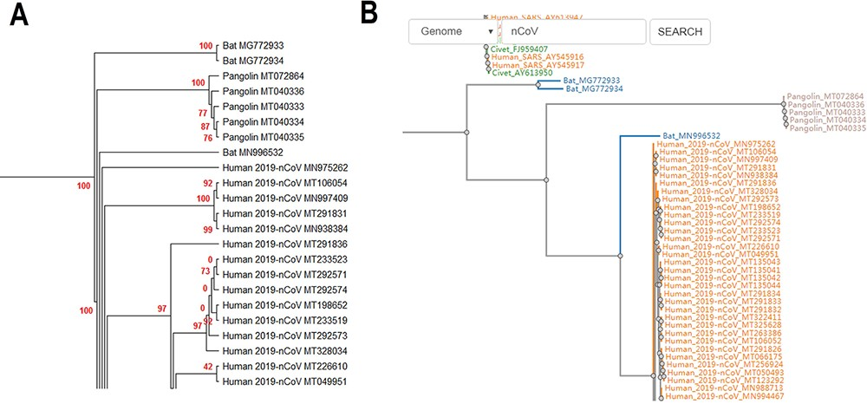
Figure 2. (A) Partial display of the phylogenetic tree built by all coronavirus genomes documented in CoVdb. Red ...
Notes:
Figure 2. (A) Partial display of the phylogenetic tree built by all coronavirus genomes documented in CoVdb. Red numbers are marginal likelihoods. (B) Snapshot showing that users can search a strain by name in a phylogenetic tree. Both A and B center on the split of Bat_MN996532 and 2019-nCoV (SARS-CoV-2).
Unless provided in the caption above, the following copyright applies to the content of this slide: © The Author(s) 2020. Published by Oxford University Press.This is an Open Access article distributed under the terms of the Creative Commons Attribution License (http://creativecommons.org/licenses/by/4.0/), which permits unrestricted reuse, distribution, and reproduction in any medium, provided the original work is properly cited.

Slide 3
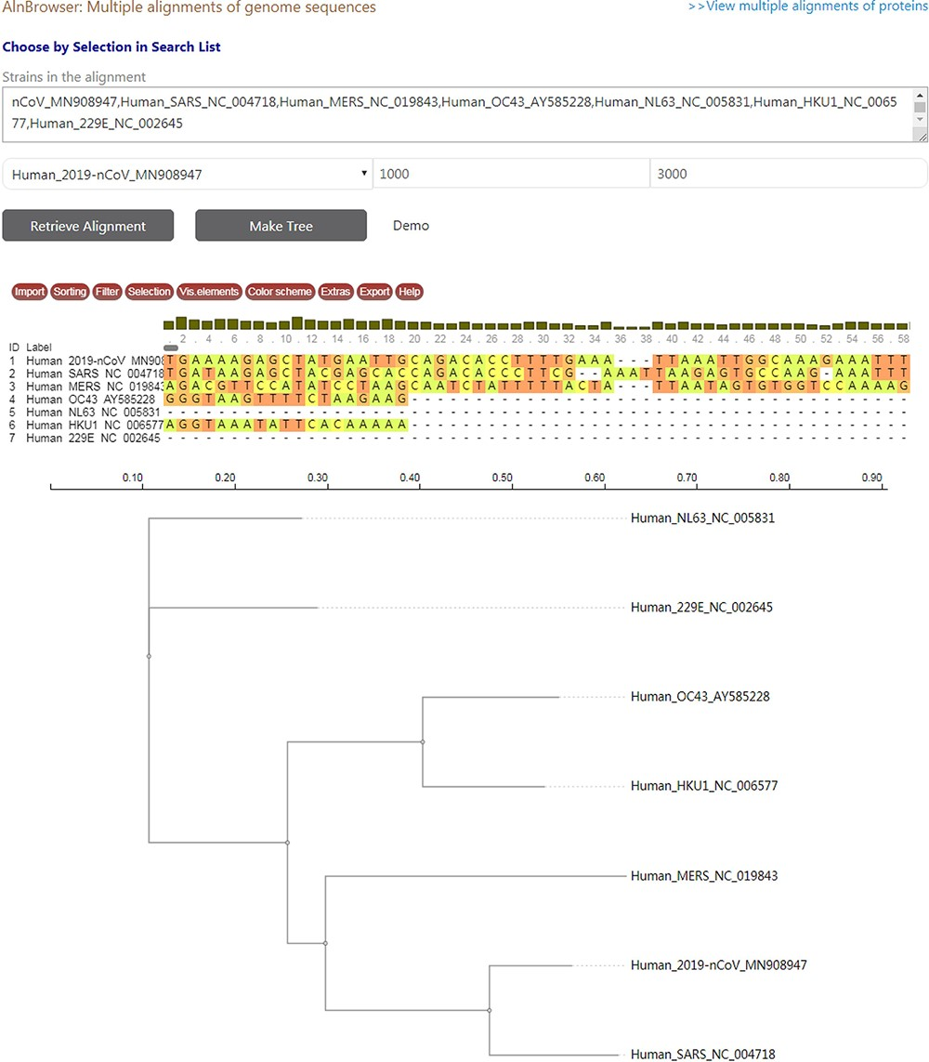
Figure 3. A snapshot displaying the usage of ‘Aln Browser’, where users need to select the reference strain, the start ...
Notes:
Figure 3. A snapshot displaying the usage of ‘Aln Browser’, where users need to select the reference strain, the start position, the end position and the strains to be put in alignment. If clicking on the button ‘Retrieve Alignment’, a multiple alignment of selected strains will be shown below. If clicking on ‘Make Tree’, a phylogenetic tree will be built basing on the alignment and shown at the bottom.
Unless provided in the caption above, the following copyright applies to the content of this slide: © The Author(s) 2020. Published by Oxford University Press.This is an Open Access article distributed under the terms of the Creative Commons Attribution License (http://creativecommons.org/licenses/by/4.0/), which permits unrestricted reuse, distribution, and reproduction in any medium, provided the original work is properly cited.

