Slide 1
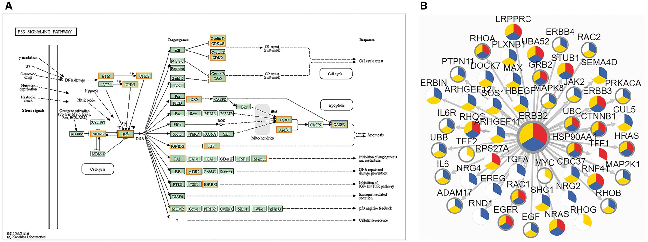
Figure 5. The result of ‘Networks’ query way. (A) The result of ‘KEGG Pathway’ query. Candidate proteins should be ...
Notes:
Figure 5. The result of ‘Networks’ query way. (A) The result of ‘KEGG Pathway’ query. Candidate proteins should be entered first and KEGG pathway ID should be selected. A colored KEGG pathway will be drawn with drug targets highlighted in the result. Orange means drug targets in our database, blue means the queried proteins. (B) The result of ‘PPI’ query. The page demonstrates association network of ERBB2 in Breast cancer with 900 score threshold of network edge and multi-level annotation of network node. Nodes are divided into three colored sectors. Red means the protein is differentially expressed. Blue means the protein is with variations. Yellow means the protein has PTMs. The gray edge means that this protein is a drug target.
Unless provided in the caption above, the following copyright applies to the content of this slide: © The Author(s) 2018. Published by Oxford University Press.This is an Open Access article distributed under the terms of the Creative Commons Attribution License (http://creativecommons.org/licenses/by/4.0/), which permits unrestricted reuse, distribution, and reproduction in any medium, provided the original work is properly cited.

