Slide 1
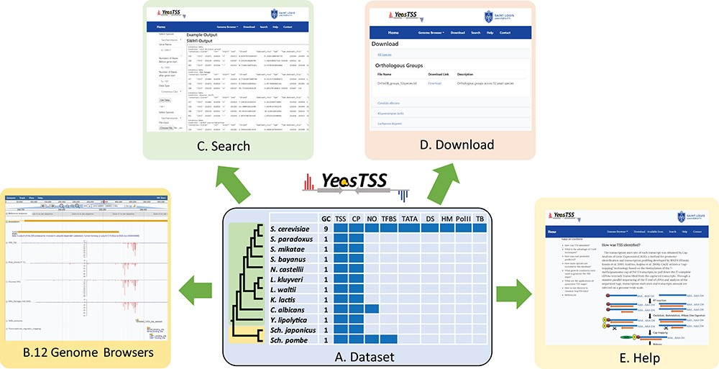
Figure 1 The overall design of YeasTSS. (A) Dataset: The dataset used in YeasTSS is illustrated in this central table. ...
Notes:
Figure 1 The overall design of YeasTSS. (A) Dataset: The dataset used in YeasTSS is illustrated in this central table. Currently, YeasTSS includes 12 yeast species. The evolutionary relationships of these species are demonstrated by the phylogenetic tree on the left side of data table. The clade of 10 budding yeast species is shaded in green, and the clade of 2 fission yeast species is shaded in yellow. The CP and TSS data of each species were generated by this study. NO data are integrated for S. cerevisiae, Sch. pombe and C. albicans. TFBSs are available in S. cerevisiae and Sch. pombe. For S. cerevisiae, several other functional genomic data are also integrated: TATA-box, DS, HMs, Polymerase II binding (PolII) and TBs obtained from 18 different growth conditions. (B) Genome browser: These data are visualized and integrated by dedicated JBrowse genome browser of each species. (C) Search: The `Search’ utility provides search tools in to retrieve TSS and CP information from gene-by-gene analysis or global approaches. (D) Download: The `Download’ utility allows users to download all raw data used in this database through web interface. (E) Help: The `Help’ page provides documentations about of CAGE technique, TSS identification, inferences of CPs and instructions of using genome browsers.
Unless provided in the caption above, the following copyright applies to the content of this slide: © The Author(s) 2019. Published by Oxford University Press.This is an Open Access article distributed under the terms of the Creative Commons Attribution License (http://creativecommons.org/licenses/by/4.0/), which permits unrestricted reuse, distribution, and reproduction in any medium, provided the original work is properly cited.

