Slide 1
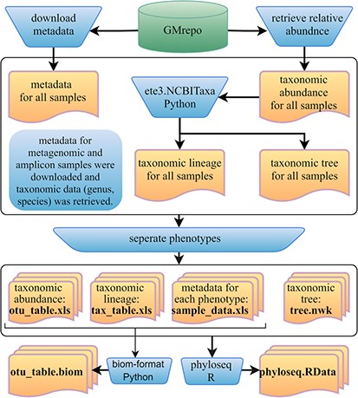
Figure 7 Framework of the GMrepo ML repository construction. Operation steps are indicated in the blue ...
Notes:
Figure 7 Framework of the GMrepo ML repository construction. Operation steps are indicated in the blue inverse-trapezoids. Files with names in bold are all contained in the repository, and they can be retrieved from the ‘Metagenomics data’ page of the server or from the GitHub.
Unless provided in the caption above, the following copyright applies to the content of this slide: © The Author(s) 2020. Published by Oxford University Press.This is an Open Access article distributed under the terms of the Creative Commons Attribution License (http://creativecommons.org/licenses/by/4.0/), which permits unrestricted reuse, distribution, and reproduction in any medium, provided the original work is properly cited.

