Slide 1
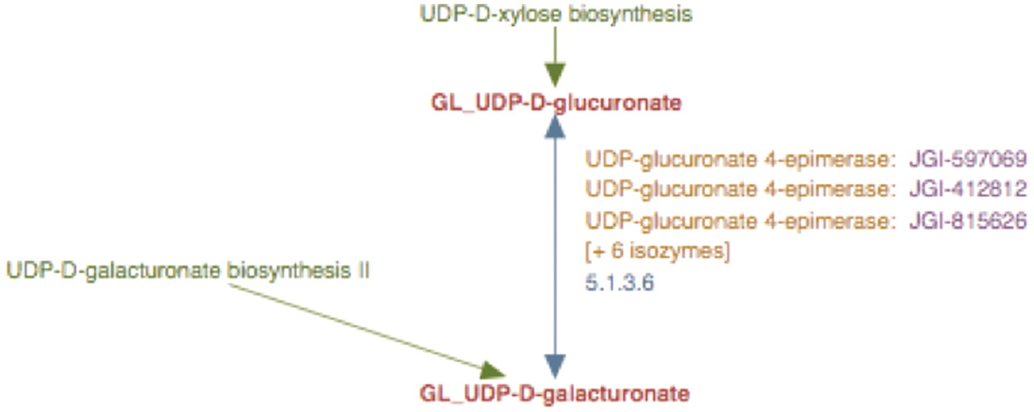
Figure 5. The enhanced representation of UDP-d-galacturonate biosynthesis I pathway starting from UDP-d-glucuronate in ...
Notes:
Figure 5. The enhanced representation of UDP-d-galacturonate biosynthesis I pathway starting from UDP-d-glucuronate in prototype Populus PGDB. The two metabolites in this pathway are linked by green arrows to two other pathways, UDP-d-xylose biosynthesis and UDP-d-galacturonate biosynthesis II.
Unless provided in the caption above, the following copyright applies to the content of this slide: © The Author(s) 2012. Published by Oxford University Press.This is an Open Access article distributed under the terms of the Creative Commons Attribution Non-Commercial License (http://creativecommons.org/licenses/by-nc/3.0), which permits unrestricted non-commercial use, distribution, and reproduction in any medium, provided the original work is properly cited.

