Slide 1
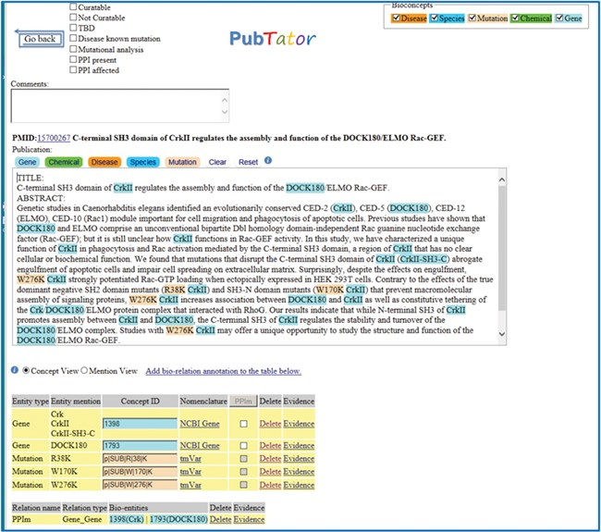
Figure 1 A positive example from the Biocreative VI Precision Medicine Track corpus.
Notes:
Figure 1 A positive example from the Biocreative VI Precision Medicine Track corpus.
Unless provided in the caption above, the following copyright applies to the content of this slide: Published by Oxford University Press 2019.This work is written by US Government employees and is in the public domain in the US.

