Slide 1
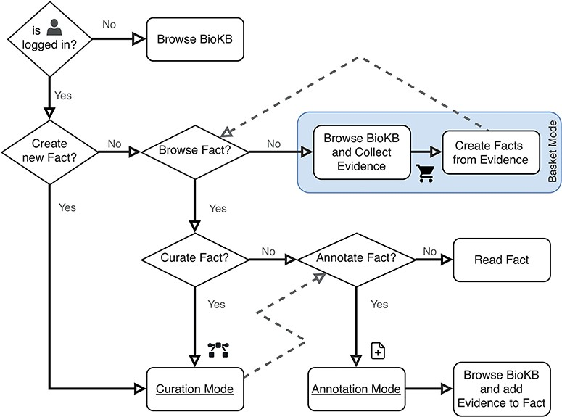
Figure 3. Flowchart describing the user operation flow and the different operation modes. The box shows the basket ...
Notes:
Figure 3. Flowchart describing the user operation flow and the different operation modes. The box shows the basket mode, which is the default operation mode when both curation and annotation modes are disabled.
Unless provided in the caption above, the following copyright applies to the content of this slide: © The Author(s) 2024. Published by Oxford University Press.This is an Open Access article distributed under the terms of the Creative Commons Attribution License (https://creativecommons.org/licenses/by/4.0/), which permits unrestricted reuse, distribution, and reproduction in any medium, provided the original work is properly cited.

