Slide 1
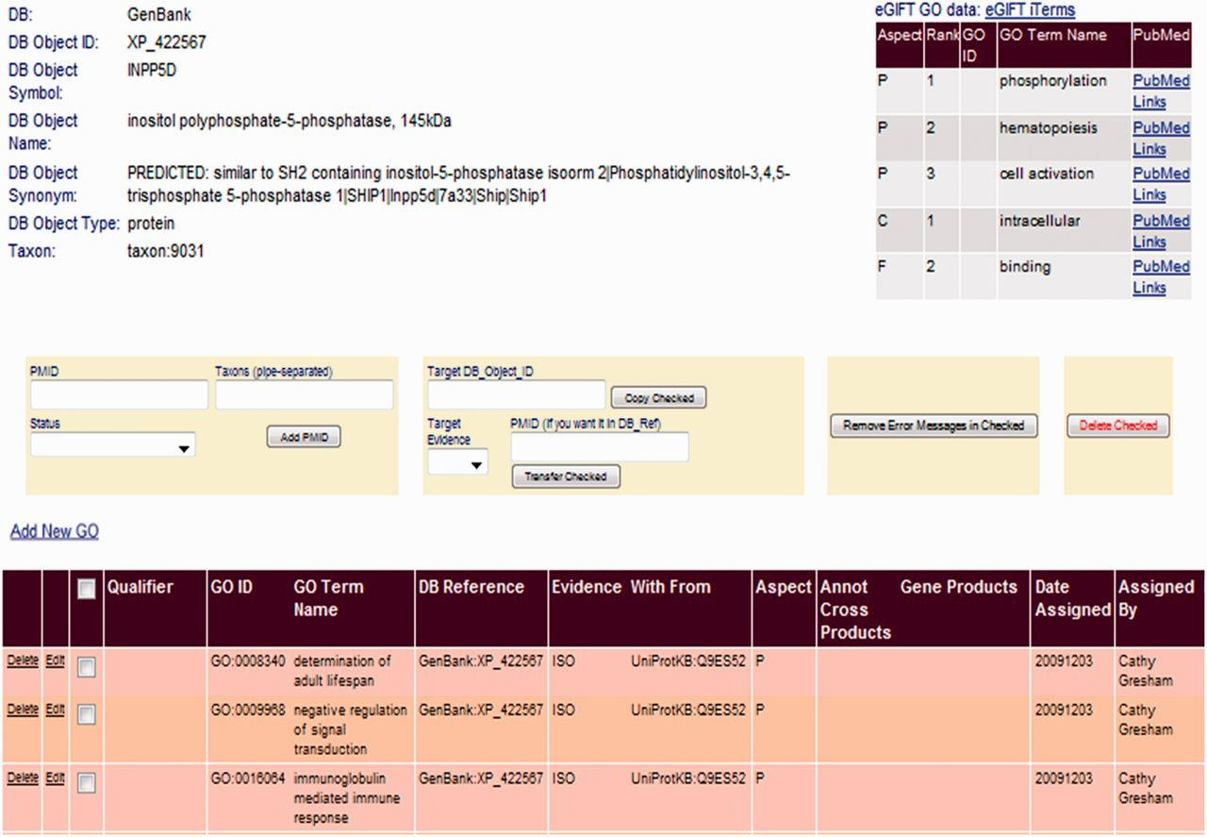
Figure 3 Linking eGIFT to the AgBase BI. A summary of eGIFT GO terms and links to corresponding literature is ...
Notes:
Figure 3 Linking eGIFT to the AgBase BI. A summary of eGIFT GO terms and links to corresponding literature is displayed in the top right hand corner of each gene product page in the AgBase BI. This table allows biocurators to rapidly identify potential new GO Terms and link out to relevant literature.
Unless provided in the caption above, the following copyright applies to the content of this slide: © The Author(s) 2012. Published by Oxford University Press.This is an Open Access article distributed under the terms of the Creative Commons Attribution License (http://creativecommons.org/licenses/by-nc/3.0/), which permits non-commercial reuse, distribution, and reproduction in any medium, provided the original work is properly cited. For commercial re-use, please contact journals.permissions@oup.com.

