Slide 1
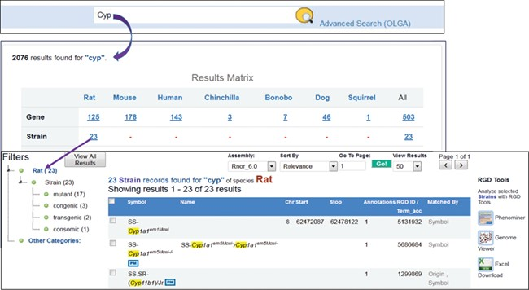
Figure 6 Finding rat strains associated with the cytochrome P450 superfamily. Using the keyword ‘cyp’ in the general ...
Notes:
Figure 6 Finding rat strains associated with the cytochrome P450 superfamily. Using the keyword ‘cyp’ in the general search retrieves RGD data associated with the gene family. Returned results are displayed in a matrix with species as the column titles. There are 23 rat strains associated with the gene family.
Unless provided in the caption above, the following copyright applies to the content of this slide: © The Author(s) 2019. Published by Oxford University Press.This is an Open Access article distributed under the terms of the Creative Commons Attribution License (http://creativecommons.org/licenses/by/4.0/), which permits unrestricted reuse, distribution, and reproduction in any medium, provided the original work is properly cited.

