Slide 1
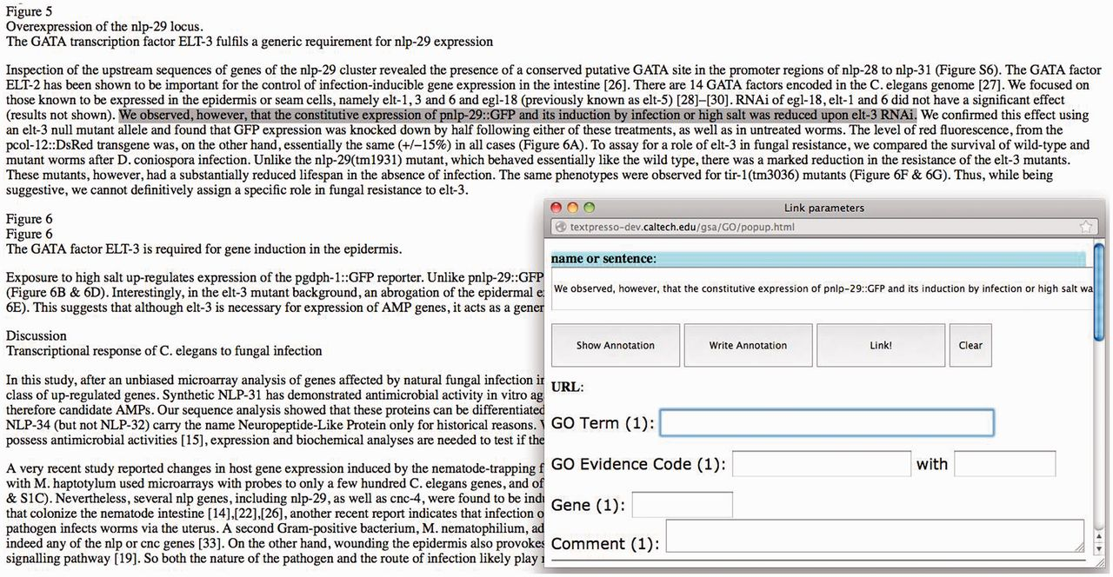
Figure 1. Screenshot of the GO annotation tool. When a line or more of text is highlighted, a pop-up window appears ...
Notes:
Figure 1. Screenshot of the GO annotation tool. When a line or more of text is highlighted, a pop-up window appears where annotation data are entered.
Unless provided in the caption above, the following copyright applies to the content of this slide: Published by Oxford University Press 2014. This work is written by US Government employees and is in the public domain in the US.

Slide 2
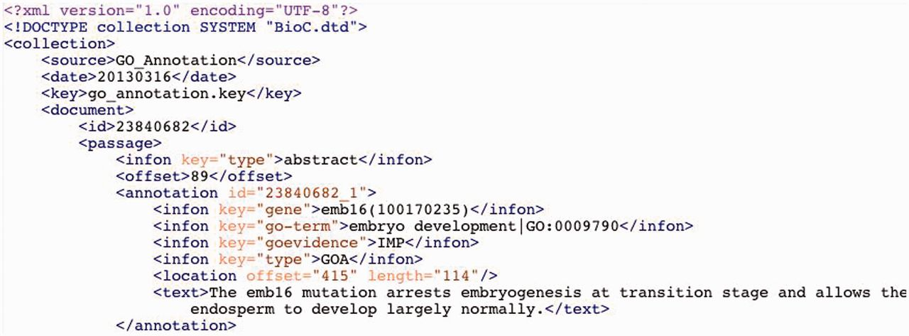
Figure 2. A sample of GO annotation in BioC format.
Notes:
Figure 2. A sample of GO annotation in BioC format.
Unless provided in the caption above, the following copyright applies to the content of this slide: Published by Oxford University Press 2014. This work is written by US Government employees and is in the public domain in the US.

Slide 3
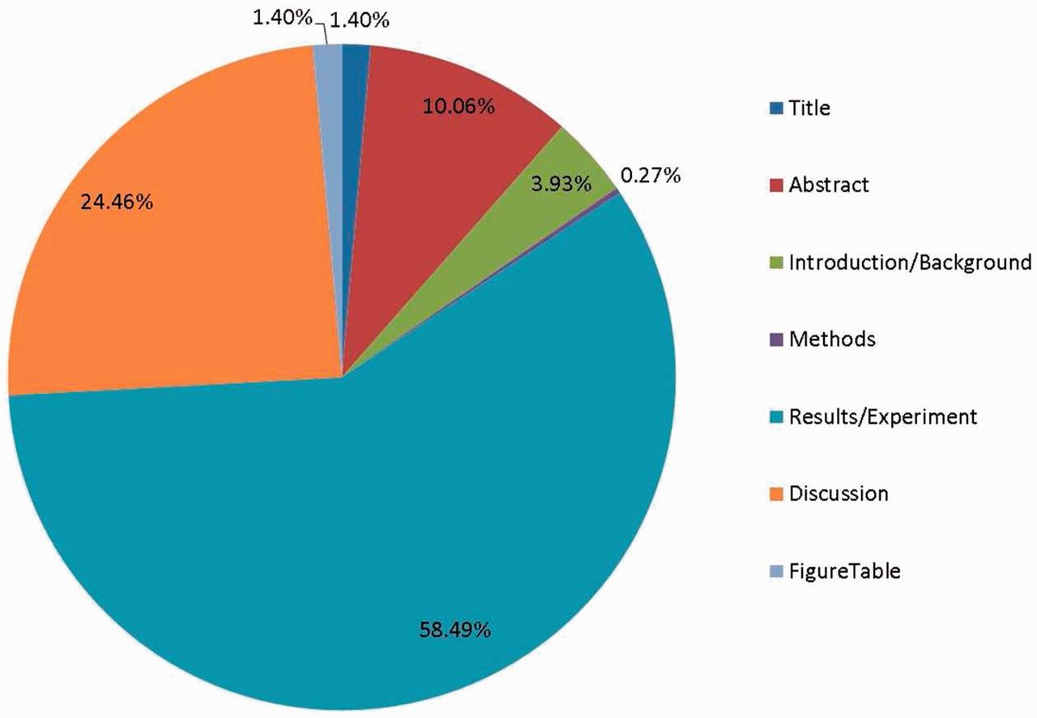
Figure 3. The proportion of annotated evidence text in different parts of the article.
Notes:
Figure 3. The proportion of annotated evidence text in different parts of the article.
Unless provided in the caption above, the following copyright applies to the content of this slide: Published by Oxford University Press 2014. This work is written by US Government employees and is in the public domain in the US.

Slide 4
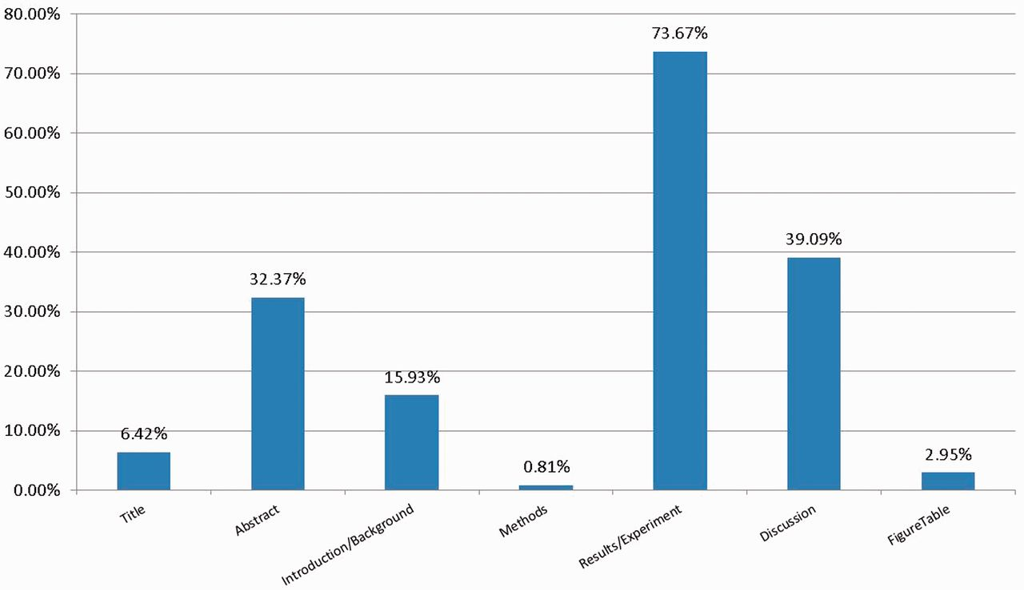
Figure 4. The proportion of GO terms appearing in different parts of the article.
Notes:
Figure 4. The proportion of GO terms appearing in different parts of the article.
Unless provided in the caption above, the following copyright applies to the content of this slide: Published by Oxford University Press 2014. This work is written by US Government employees and is in the public domain in the US.

