Slide 1
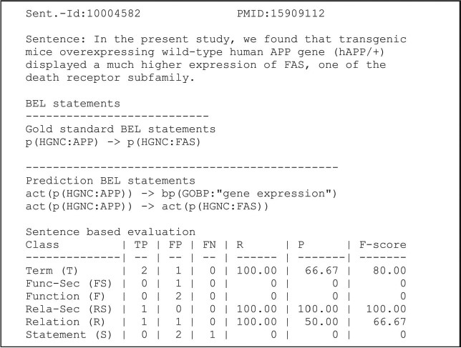
Figure 2 An example of a candidate evaluation. The example shows the candidate sentence, the gold standard and ...
Notes:
Figure 2 An example of a candidate evaluation. The example shows the candidate sentence, the gold standard and predicted statements. The scores are provided for all primary and secondary levels (8). Abbreviations: PMID (PubMed identifier), true positive (TP), false positive (FP), false negative (FN), recall (R), precision (P). Adapted and reprinted with permission from Fluck et al. (7).
Unless provided in the caption above, the following copyright applies to the content of this slide: © The Author(s) 2019. Published by Oxford University Press.This is an Open Access article distributed under the terms of the Creative Commons Attribution License (http://creativecommons.org/licenses/by/4.0/), which permits unrestricted reuse, distribution, and reproduction in any medium, provided the original work is properly cited.

