Slide 1
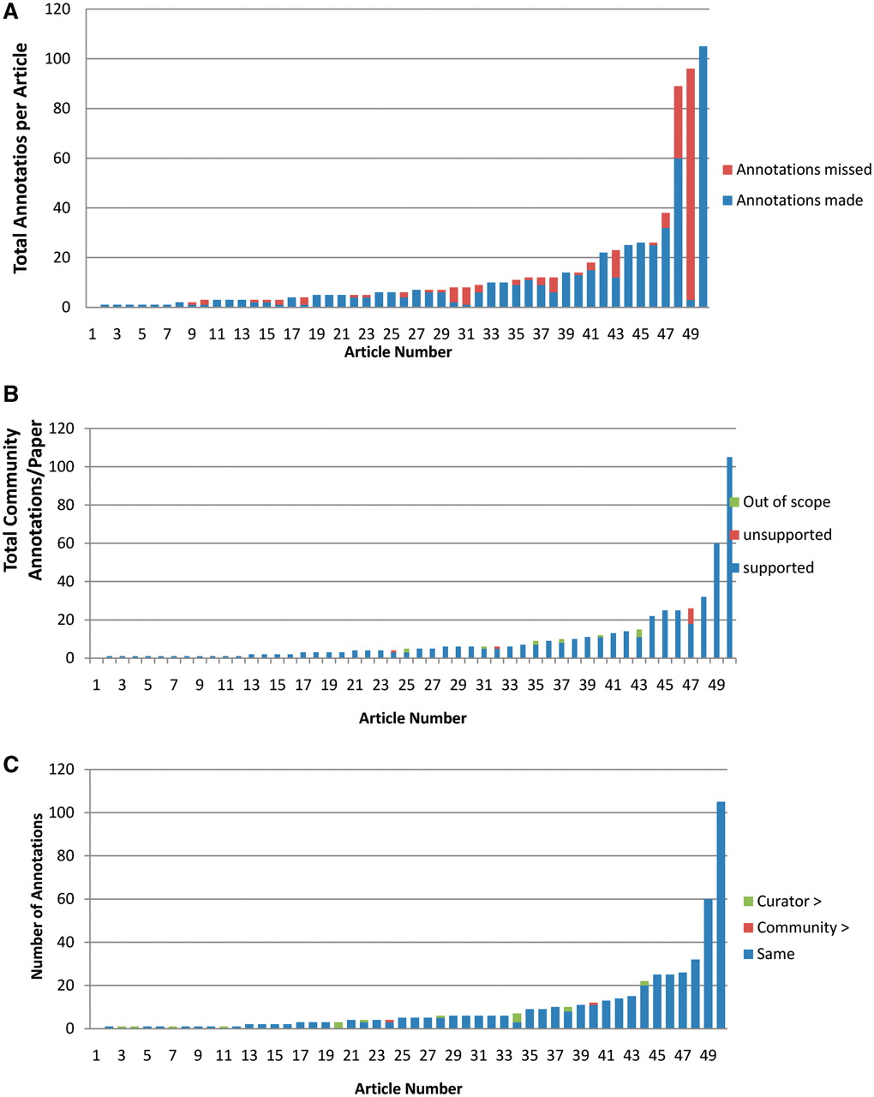
Figure 4. Analysis of community annotations. (A) Completeness of community annotations. The 50 articles analyzed are ...
Notes:
Figure 4. Analysis of community annotations. (A) Completeness of community annotations. The 50 articles analyzed are shown on X-axis, and the total number of curator and community annotations per paper shown on the Y-axis. The number of community annotations is shown in blue, and the number of added curator annotations in orange. (B) Experimental support for community annotations. Supported community annotations in blue, unsupported community annotations in orange, out of scope annotations in green. (C) Level of specificity of community annotations. Papers shown on X-axis, total number of community annotations per paper shown on Y-axis. Community annotations with same specificity as curator annotations are shown in blue, more specific community annotations in orange, more specific curator annotations in green.
Unless provided in the caption above, the following copyright applies to the content of this slide: © The Author(s) 2012. Published by Oxford University Press.This is an Open Access article distributed under the terms of the Creative Commons Attribution Non-Commercial License (http://creativecommons.org/licenses/by-nc/3.0), which permits unrestricted non-commercial use, distribution, and reproduction in any medium, provided the original work is properly cited.

