Slide 1
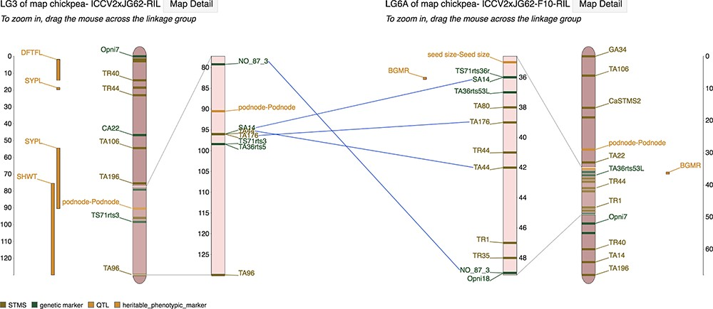
Figure 3 Marker correspondences on the MapViewer main interface page showing lines drawn between linkage groups ...
Notes:
Figure 3 Marker correspondences on the MapViewer main interface page showing lines drawn between linkage groups connecting markers that are shared between the reference and comparison linkage group.
Unless provided in the caption above, the following copyright applies to the content of this slide: © The Author(s) 2019. Published by Oxford University Press.This work is written by US Government employees and is in the public domain in the US.

