Slide 1
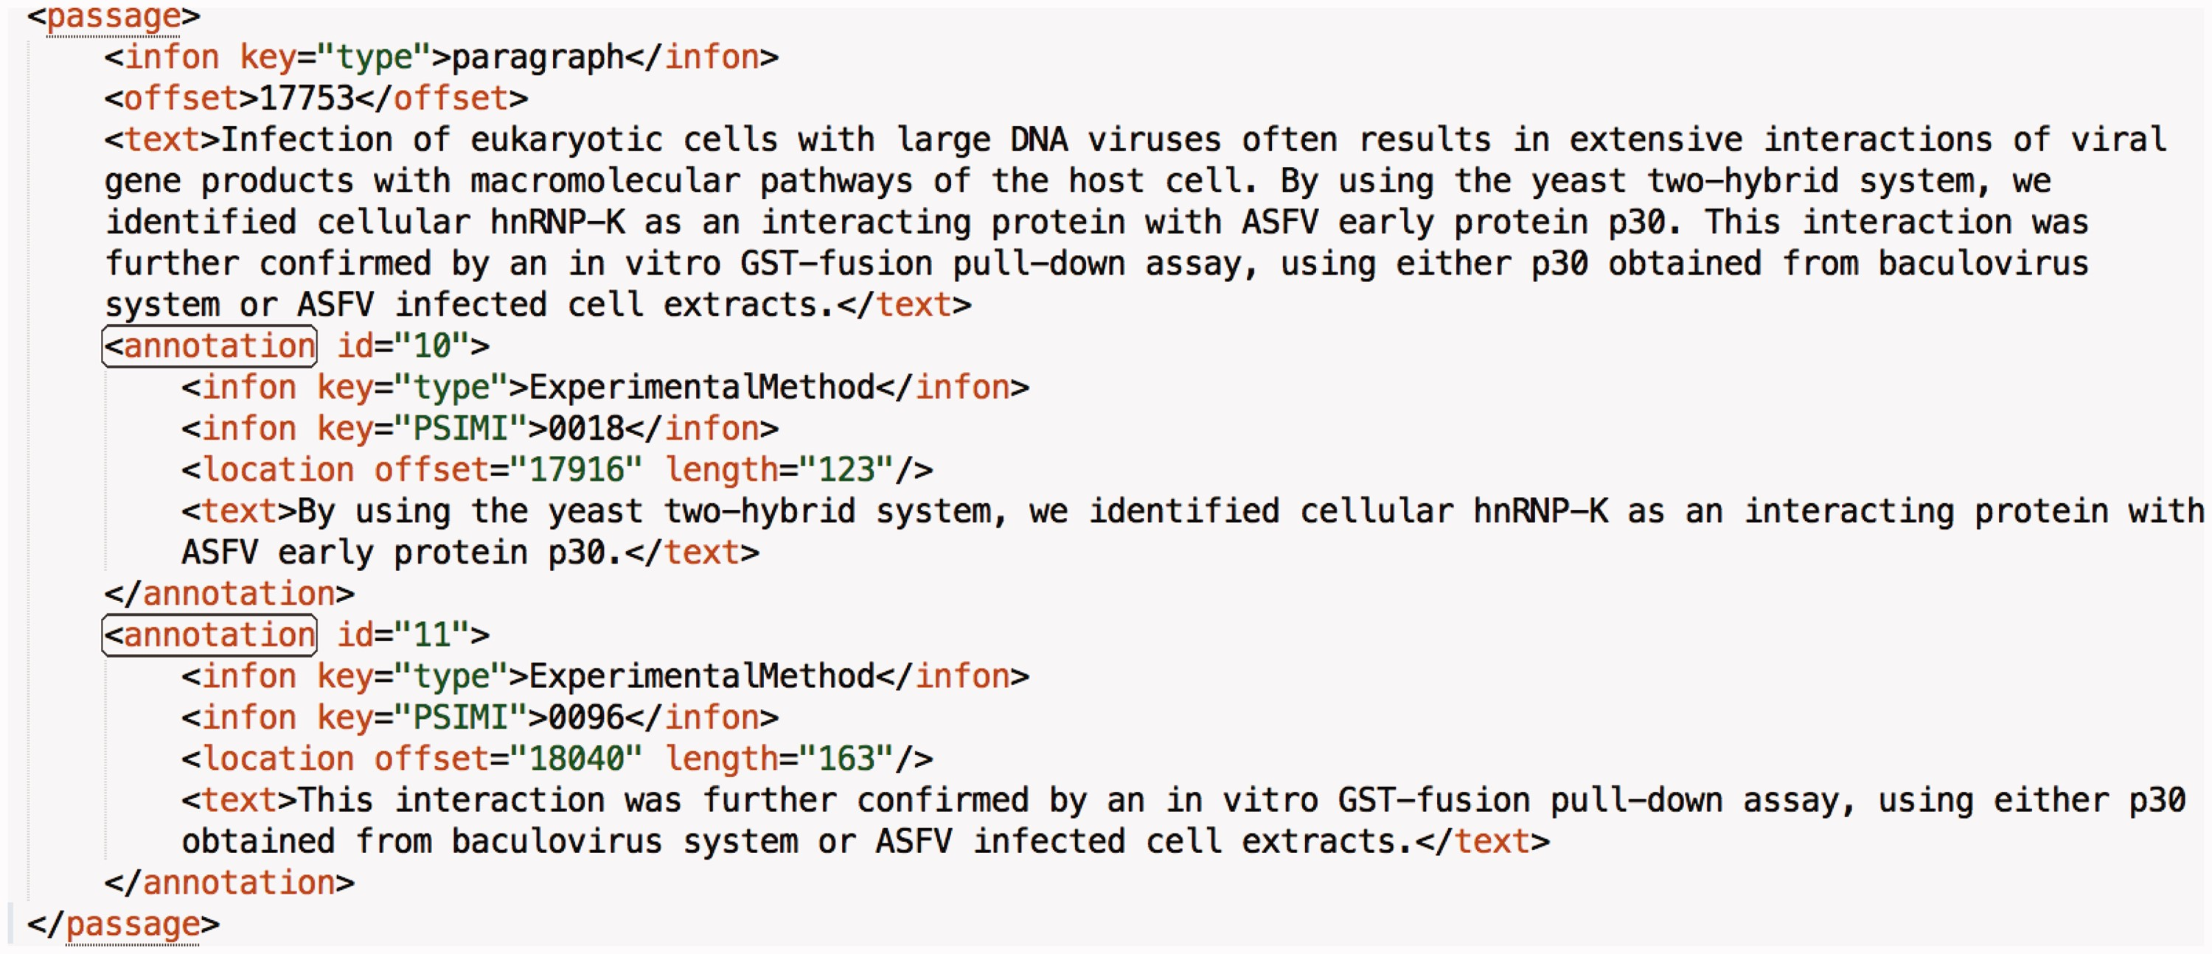
Figure 2. A sample annotation from a paragraph of an article in the data set. Each annotation has an identifier that is ...
Notes:
Figure 2. A sample annotation from a paragraph of an article in the data set. Each annotation has an identifier that is incremented by one throughout the article. Moreover, the value of the ‘type’ infon is static and set to ‘ExperimentalMethod’ for all annotations. The value of the ‘PSIMI’ infon is set to the PSI-MI identifier of the interaction detection method. The ‘text’ tag holds the annotated sentence(s). The ‘location’ tag holds the position of the annotated portion in the article with the ‘offset’ and ‘length’ attributes.
Unless provided in the caption above, the following copyright applies to the content of this slide: © The Author(s) 2017. Published by Oxford University Press.This is an Open Access article distributed under the terms of the Creative Commons Attribution License (http://creativecommons.org/licenses/by/4.0/), which permits unrestricted reuse, distribution, and reproduction in any medium, provided the original work is properly cited.

