Slide 1
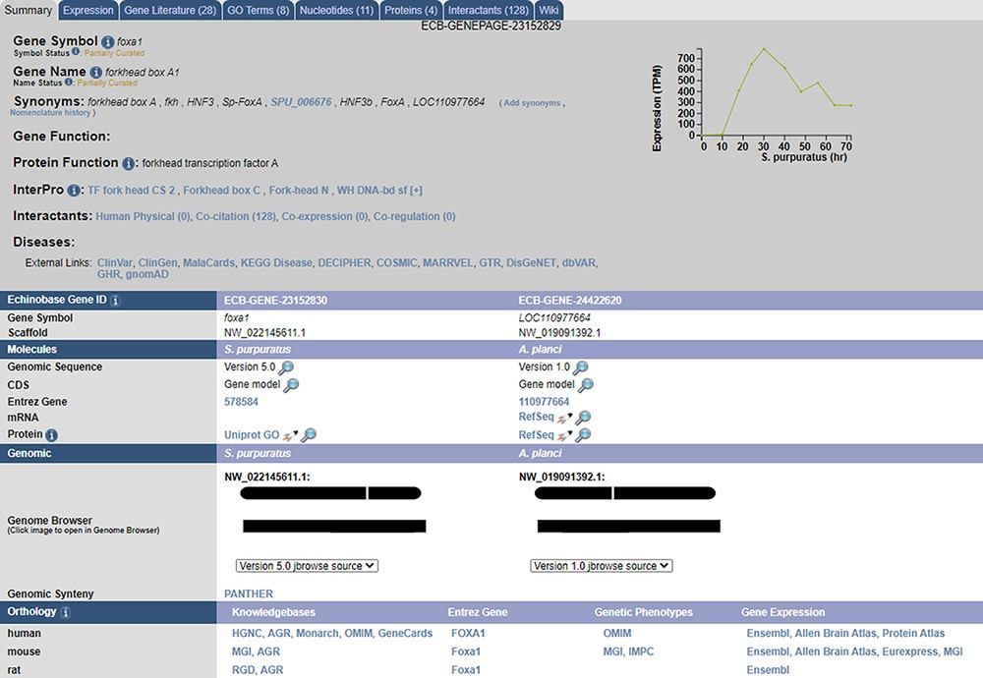
Figure 2. A sample gene summary page for foxa1. The updated developmental time course is shown in the top right. The ...
Notes:
Figure 2. A sample gene summary page for foxa1. The updated developmental time course is shown in the top right. The ortholog of the gene in different echinoderms, as predicted by our pipeline, is seen under the ‘Echinobase Gene ID’ section. The gene can be viewed in JBrowse by clicking the links under the ‘Genomic’ section. Additional orthologs to non-echinoderm species as predicted by NCBI and are reported under the ‘Orthology’ section.
Unless provided in the caption above, the following copyright applies to the content of this slide: © The Author(s) 2021. Published by Oxford University Press.This is an Open Access article distributed under the terms of the Creative Commons Attribution License (http://creativecommons.org/licenses/by/4.0/), which permits unrestricted reuse, distribution, and reproduction in any medium, provided the original work is properly cited.

