Slide 1
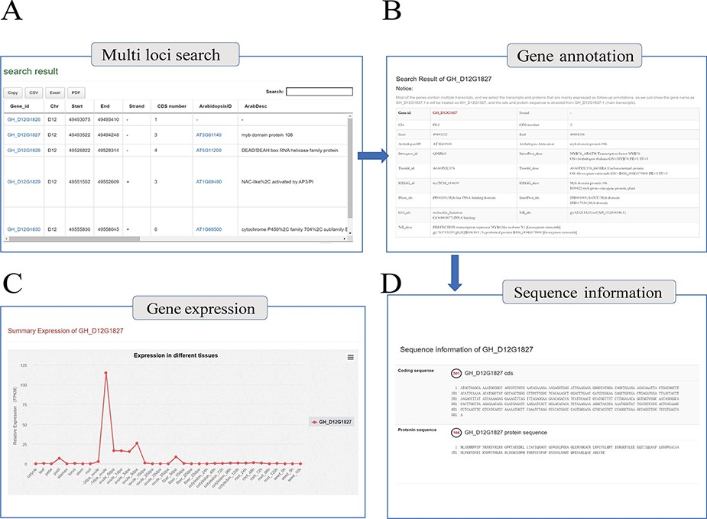
Figure 2. Genome annotation query interface. (A) Multi-loci query interface. (B) COTTONOMICS returns detailed ...
Notes:
Figure 2. Genome annotation query interface. (A) Multi-loci query interface. (B) COTTONOMICS returns detailed information regarding the functional annotation, location, etc. (C) Expression of the query gene; the interface use dot plots to indicate the expression level of the query gene in different tissues. (D) Sequence information of gene locus GH_D12G1827.
Unless provided in the caption above, the following copyright applies to the content of this slide: © The Author(s) 2022. Published by Oxford University Press.This is an Open Access article distributed under the terms of the Creative Commons Attribution-NonCommercial License (https://creativecommons.org/licenses/by-nc/4.0/), which permits non-commercial re-use, distribution, and reproduction in any medium, provided the original work is properly cited. For commercial re-use, please contact journals.permissions@oup.com

