Slide 1
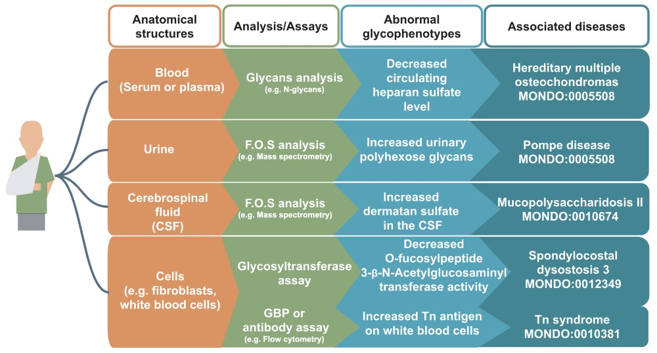
Figure 2 Examples of glycophenotypes that can be captured from various laboratory techniques From a patient’s ...
Notes:
Figure 2 Examples of glycophenotypes that can be captured from various laboratory techniques From a patient’s anatomical structures (indicated in orange boxes, e.g. blood), glycans such as free oligosaccharides (F.O.S.) and glycan-related molecules can be analyzed by standard glycomics assays (indicated in green boxes, e.g. GBP or antibody assay). Patients’ glycophenotypes indicated in the blue boxes can be captured from publications: decreased circulating HS level (82), increased urinary polyhexose glycans (36), increased dermatan sulfate in the CSF (83), decreased O-Fucosylpeptide 3-beta-N-acetylglucosaminyltransferase activity (84) and increased Tn antigen in white blood cells (85). In our preliminary work, we have logically defined design patterns (86) that would generate hundreds of classes, but they are not yet fully integrated in the HPO.
Unless provided in the caption above, the following copyright applies to the content of this slide: © The Author(s) 2019. Published by Oxford University Press.This is an Open Access article distributed under the terms of the Creative Commons Attribution License (http://creativecommons.org/licenses/by/4.0/), which permits unrestricted reuse, distribution, and reproduction in any medium, provided the original work is properly cited.

Slide 2
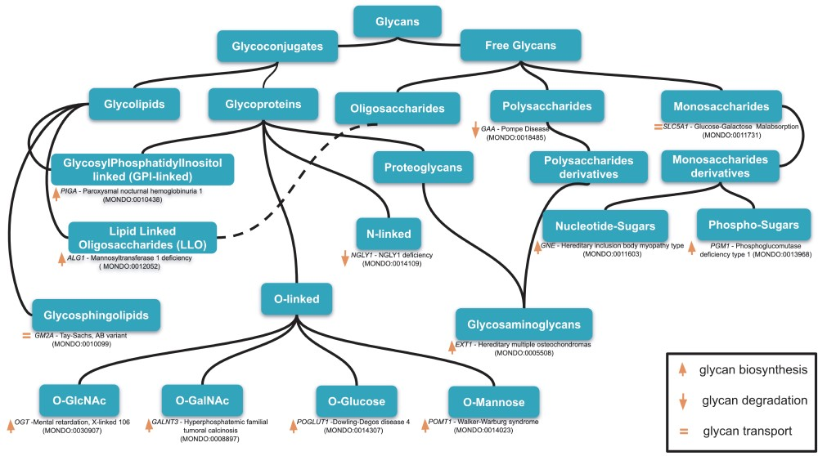
Figure 1 An example of classification of relevant glycans involved in human diseases based on the essential of ...
Notes:
Figure 1 An example of classification of relevant glycans involved in human diseases based on the essential of glycobiology and CHEBI ontology. Glycans can be free or conjugated to macromolecules (protein, lipids). Free glycans can be monosaccharides (n = 1), oligosaccharides (2 < n 10), and their derivatives (e.g. acetylated, sulfated) 13 exemplary diseases names along with the mutated genes and MONDO ID (in parentheses) are indicated for 13 classes of glycans. Up, down orange arrows and orange equal signs indicate, respectively, the involvement of the gene products in glycan biosynthesis, degradation or transport. Based on our disease curation, there are 176 glycan-related diseases (CDG and diseases in which glycophenotypes are detectable, see online supplementary material for Table S1).
Unless provided in the caption above, the following copyright applies to the content of this slide: © The Author(s) 2019. Published by Oxford University Press.This is an Open Access article distributed under the terms of the Creative Commons Attribution License (http://creativecommons.org/licenses/by/4.0/), which permits unrestricted reuse, distribution, and reproduction in any medium, provided the original work is properly cited.

Slide 3
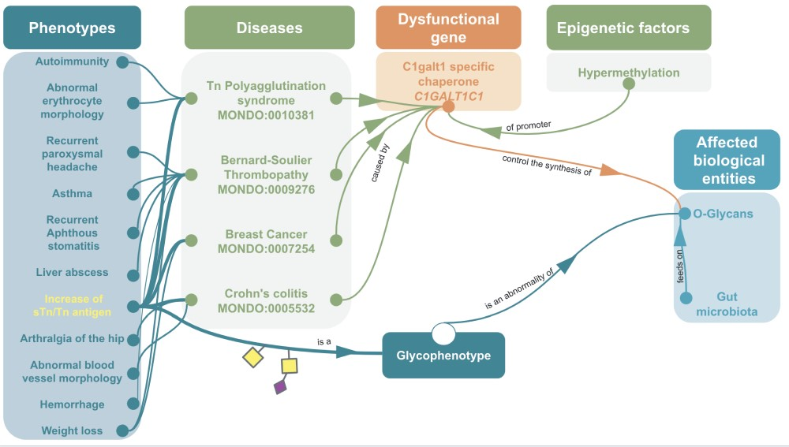
Figure 5 Example of omics integration with ontologies related to glycans: graph representation of the impact of a ...
Notes:
Figure 5 Example of omics integration with ontologies related to glycans: graph representation of the impact of a dysfunctional C1GALT1C1 on health C1GALT1C1 encodes Cosmc, a molecular chaperone for a glycosyltransferase that initiates O-GalNac glycans synthesis (T-synthase) (127). Dysfunctional Cosmc can lead to an improper T-synthase folding, thus abnormal O-glycans with the abnormal glycophenotype: increase of sTn/Tn antigen (SNFG symbols, respectively, yellow square for Tn and a purple diamond/yellow square for sTn) (128). Dysfunctional Cosmc (129) can be due to mutations or epigenetic factors, for instance the hypermethylation of C1GALT1C1’s promoter can lead to increase of sTn/Tn antigen. These two glycophenotypes are also common in many cancers (130). Mouse models have shown that C1GALT1C1 mutation can lead to abnormal O-glycans on platelets, generating bleeding disorders similar to Bernard-Soulier syndrome (MONDO:0009276) (131) Inflammatory bowel disease similar to Crohn’s Colitis (132) and abnormal microbiota (133). In fact, human gut microbiota (HGM) feeds on normal MUC2 glycans (134–136). Hence, the disruption of MUC2 glycosylation due to C1GALT1C1 mutation could potentially lead to microbiota and host physiology issue (137).
Unless provided in the caption above, the following copyright applies to the content of this slide: © The Author(s) 2019. Published by Oxford University Press.This is an Open Access article distributed under the terms of the Creative Commons Attribution License (http://creativecommons.org/licenses/by/4.0/), which permits unrestricted reuse, distribution, and reproduction in any medium, provided the original work is properly cited.

Slide 4
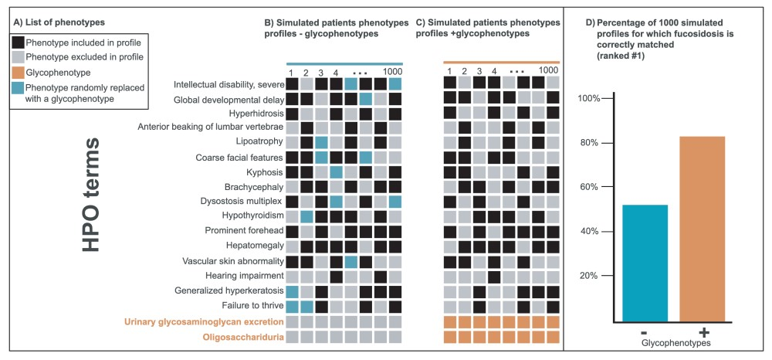
Figure 3 Improvement of disease diagnostic with molecular glycophenotypes for fucosidosis. Panel A lists 18 phenotypes ...
Notes:
Figure 3 Improvement of disease diagnostic with molecular glycophenotypes for fucosidosis. Panel A lists 18 phenotypes frequently associated with fucosidosis. The columns in Panels B and C illustrate simulated patients phenotypes profiles composed of a random selection of 10 of these 16 phenotypes. The profiles in Panel C include glycophenotypes (bottom in orange), whereas those in Panel B do not. Panel D shows that when these two groups of 1000 simulated profiles are compared for their diagnostic utility, the profiles that contain glycophenotypes (C) significantly outperform those that do not (B) (Fisher exact P-value = 8.5e-47). Moreover, more specific glycophenotypes are more diagnostically useful than more general ones. This underscores the importance of harmonizing glycophenotypes across data resources as well as collecting them from patients.
Unless provided in the caption above, the following copyright applies to the content of this slide: © The Author(s) 2019. Published by Oxford University Press.This is an Open Access article distributed under the terms of the Creative Commons Attribution License (http://creativecommons.org/licenses/by/4.0/), which permits unrestricted reuse, distribution, and reproduction in any medium, provided the original work is properly cited.

Slide 5
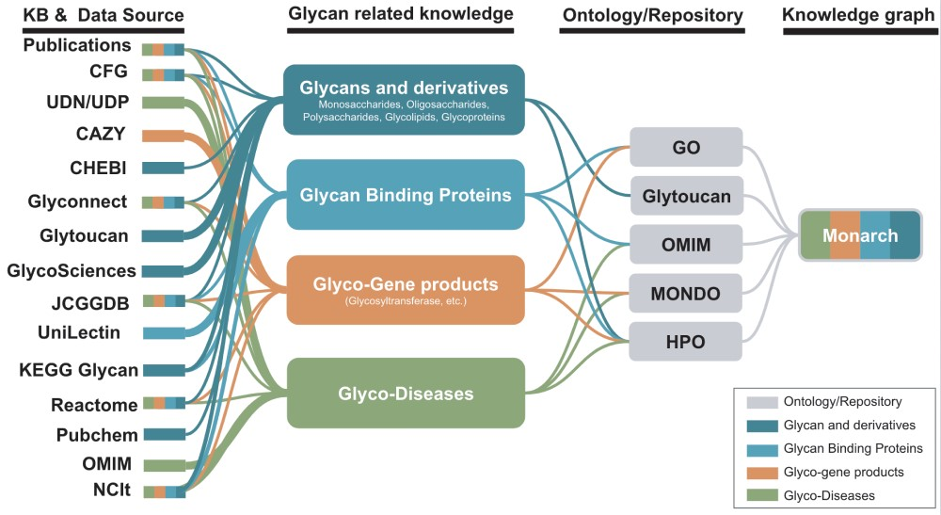
Figure 4 Potential KBs and data sources for the improvement of glycophenotypes representation for HPO and Monarch ...
Notes:
Figure 4 Potential KBs and data sources for the improvement of glycophenotypes representation for HPO and Monarch glycophenotypes related to diseases indicated in publications and KBs could be used to enhance glycan-related knowledge in Monarch.
Unless provided in the caption above, the following copyright applies to the content of this slide: © The Author(s) 2019. Published by Oxford University Press.This is an Open Access article distributed under the terms of the Creative Commons Attribution License (http://creativecommons.org/licenses/by/4.0/), which permits unrestricted reuse, distribution, and reproduction in any medium, provided the original work is properly cited.

