Slide 1
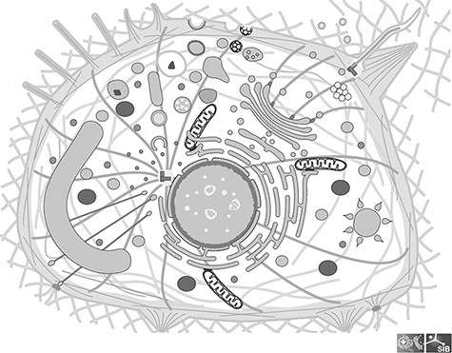
Figure 1. Image of a generic cell from the Clade Eumetazoa; This cell illustrates all the cellular components found in ...
Notes:
Figure 1. Image of a generic cell from the Clade Eumetazoa; This cell illustrates all the cellular components found in any Eumetazoan, although in reality no cell carries all of them; All components are individual groups in the SVG file, which can be hidden or colored.
Unless provided in the caption above, the following copyright applies to the content of this slide: © The Author(s) 2022. Published by Oxford University Press.This is an Open Access article distributed under the terms of the Creative Commons Attribution License (https://creativecommons.org/licenses/by/4.0/), which permits unrestricted reuse, distribution, and reproduction in any medium, provided the original work is properly cited.

Slide 2
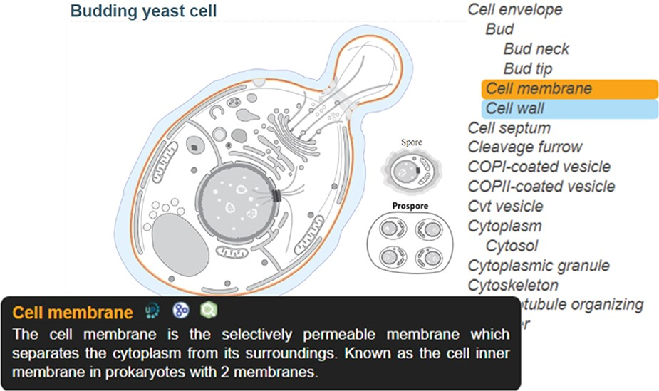
Figure 2. SwissBioPics page for budding yeast cell; The ‘Cell membrane’, selected on the sidebar list, is colored ...
Notes:
Figure 2. SwissBioPics page for budding yeast cell; The ‘Cell membrane’, selected on the sidebar list, is colored orange, with a tooltip showing a description of the organelle and links to the UniProt, AmiGO and QuickGO websites; The mouse is hovering on ‘Cell wall’ in the list, coloring this part blue.
Unless provided in the caption above, the following copyright applies to the content of this slide: © The Author(s) 2022. Published by Oxford University Press.This is an Open Access article distributed under the terms of the Creative Commons Attribution License (https://creativecommons.org/licenses/by/4.0/), which permits unrestricted reuse, distribution, and reproduction in any medium, provided the original work is properly cited.

Slide 3
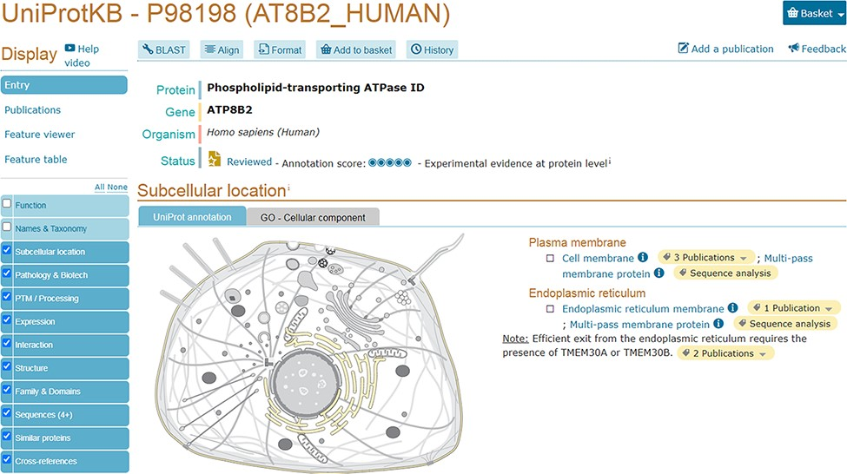
Figure 3. UniProtKB entry AT8B2_ HUMAN (P98198) shows an embedded SwissBioPics image: The generic animal cell ...
Notes:
Figure 3. UniProtKB entry AT8B2_ HUMAN (P98198) shows an embedded SwissBioPics image: The generic animal cell (Eumetazoa) is selected based on organism taxonomy; the cell membrane and endoplasmic reticulum are highlighted using annotations from the UniProt entry.
Unless provided in the caption above, the following copyright applies to the content of this slide: © The Author(s) 2022. Published by Oxford University Press.This is an Open Access article distributed under the terms of the Creative Commons Attribution License (https://creativecommons.org/licenses/by/4.0/), which permits unrestricted reuse, distribution, and reproduction in any medium, provided the original work is properly cited.

Slide 4
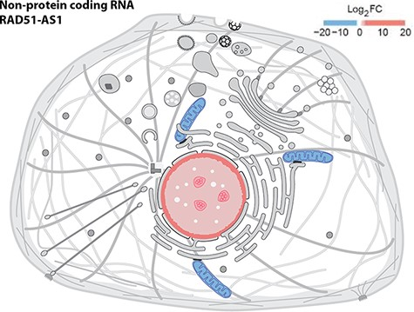
Figure 4. Displaying quantitative data in SwissBioPics using colors. The image shows the fold change (FC) of the ...
Notes:
Figure 4. Displaying quantitative data in SwissBioPics using colors. The image shows the fold change (FC) of the RAD51-AS1 non-protein-coding transcript in the nucleus and mitochondrion (26).
Unless provided in the caption above, the following copyright applies to the content of this slide: © The Author(s) 2022. Published by Oxford University Press.This is an Open Access article distributed under the terms of the Creative Commons Attribution License (https://creativecommons.org/licenses/by/4.0/), which permits unrestricted reuse, distribution, and reproduction in any medium, provided the original work is properly cited.

