Slide 1
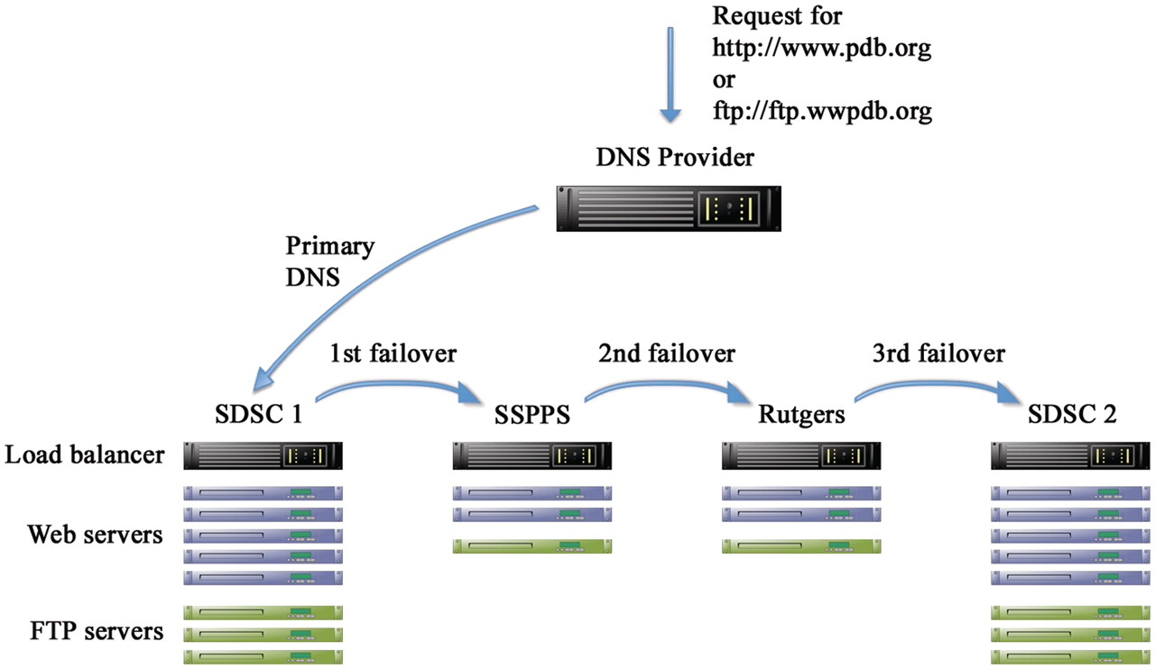
Figure 1. Schematic representation of hardware redundancy and DNS failover. There are four clusters in three separate ...
Notes:
Figure 1. Schematic representation of hardware redundancy and DNS failover. There are four clusters in three separate geographical locations: San Diego Supercomputer Center (SDSC) and Skaggs School of Pharmacy and Pharmaceutical Sciences (SSPPS), both at the University of California, San Diego (UCSD), and Rutgers, the State University of New Jersey. Each cluster contains multiple load balanced Web and FTP servers. A third party DNS provider is used to manage the DNS entries for the website (www.pdb.org) and the FTP site (ftp.wwpdb.org) including failover in case the primary cluster fails.
Unless provided in the caption above, the following copyright applies to the content of this slide: © The Author(s) 2011. Published by Oxford University Press.This is Open Access article distributed under the terms of the Creative Commons Attribution Non-Commercial License (http://creativecommons.org/licenses/by-nc/2.5), which permits unrestricted non-commercial use, distribution, and reproduction in any medium, provided the original work is properly cited.

Slide 2
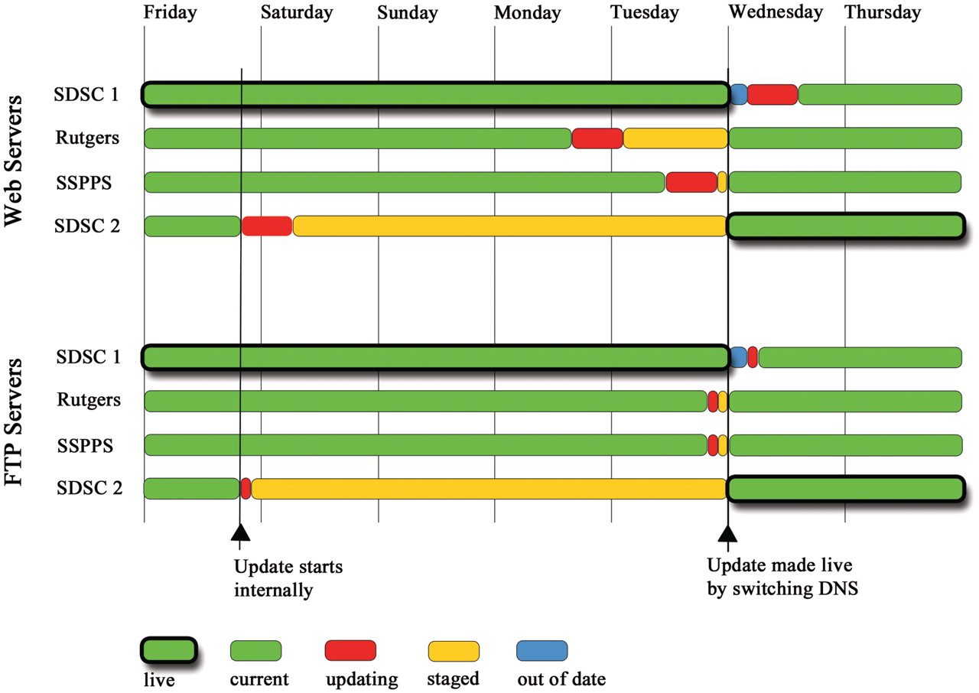
Figure 2. Staggered weekly update schedule of the Web and FTP servers. The overall aim is to balance the need for ...
Notes:
Figure 2. Staggered weekly update schedule of the Web and FTP servers. The overall aim is to balance the need for advanced staging of the update (red and orange) with as much failover to current data (green) as possible at any given time. The update cycle begins on Friday with the second SDSC cluster (SDSC 2). Two more clusters are updated on Monday and Tuesday. On Wednesday at 00:00 UTC, the update is made public by switching the DNS entry between the two SDSC clusters (thick outlines). A few hours are allowed for the DNS change to propagate until the update on the final and now out of date cluster (blue) is started. Green with thick outlines shows “live” clusters serving data to the public. Other clusters in green have the same current content. Clusters in red are being updated. Orange denotes a cluster with a finished update that contains “staged” data not yet available for public release. Blue shows a cluster whose data are out of date compared with the live public site.
Unless provided in the caption above, the following copyright applies to the content of this slide: © The Author(s) 2011. Published by Oxford University Press.This is Open Access article distributed under the terms of the Creative Commons Attribution Non-Commercial License (http://creativecommons.org/licenses/by-nc/2.5), which permits unrestricted non-commercial use, distribution, and reproduction in any medium, provided the original work is properly cited.

Slide 3
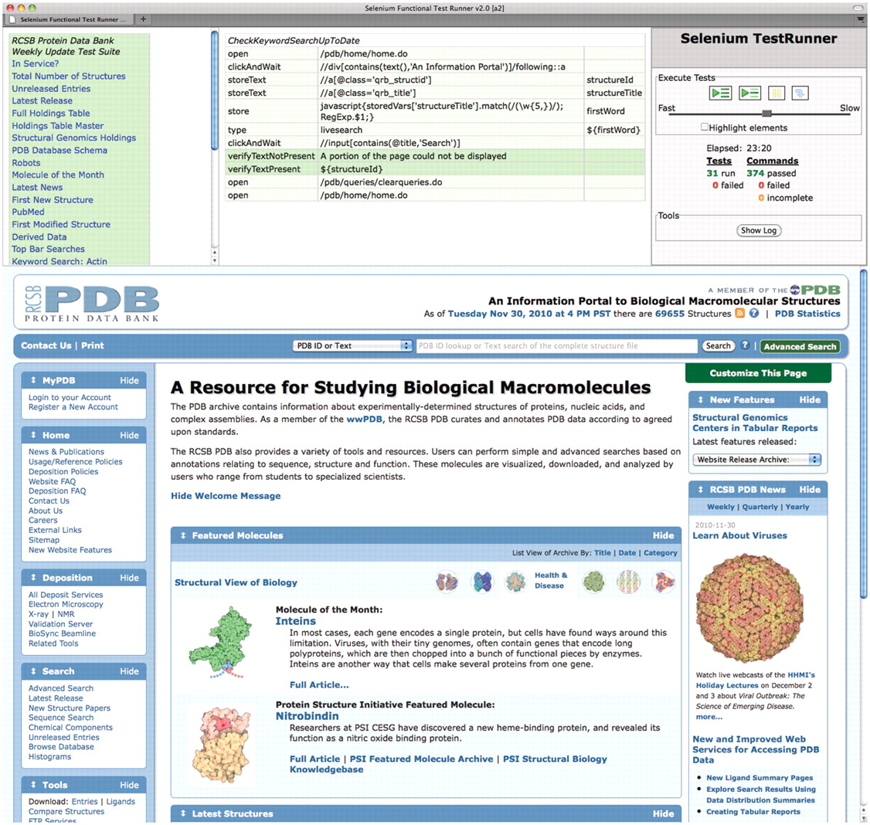
Figure 3. Screenshot of fully executed Selenium IDE test suite in a Firefox browser. We have developed an extensive ...
Notes:
Figure 3. Screenshot of fully executed Selenium IDE test suite in a Firefox browser. We have developed an extensive suite of testing scripts with several goals such as checking key elements of the user interface, verifying the integrity of the weekly update, and comparing results between multiple servers. The top-left panel shows the list of test scripts. The top-middle panel shows as an example the script for verifying that keyword searches are up to date. It selects the first entry ID from the weekly release, extracts a keyword from its title, and then performs a search for this keyword and asserts that the search results include the given entry ID. The top-right panel contains the controls for executing tests and shows the test results. The bottom panel is a regular browser window that shows the web pages being loaded by the scripts.
Unless provided in the caption above, the following copyright applies to the content of this slide: © The Author(s) 2011. Published by Oxford University Press.This is Open Access article distributed under the terms of the Creative Commons Attribution Non-Commercial License (http://creativecommons.org/licenses/by-nc/2.5), which permits unrestricted non-commercial use, distribution, and reproduction in any medium, provided the original work is properly cited.

Slide 4
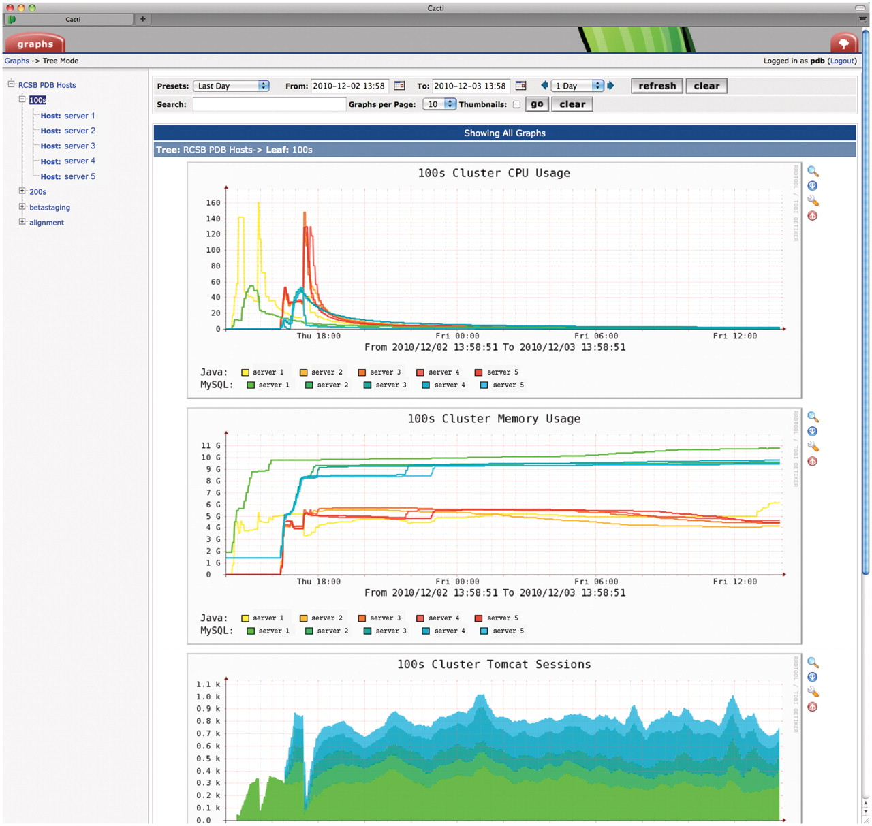
Figure 4. Screenshot of Cacti monitoring tool (www.cacti.net). Parameters such as internal and external traffic, CPU ...
Notes:
Figure 4. Screenshot of Cacti monitoring tool (www.cacti.net). Parameters such as internal and external traffic, CPU and memory usage, thread counts and Tomcat session counts are collected every few minutes and presented in graphical form for each server or cluster. The time window starts after the cluster had just been reinstalled with a new quarterly software release and shows the server load during successive Selenium tests on each server. Server names are redacted for security reasons.
Unless provided in the caption above, the following copyright applies to the content of this slide: © The Author(s) 2011. Published by Oxford University Press.This is Open Access article distributed under the terms of the Creative Commons Attribution Non-Commercial License (http://creativecommons.org/licenses/by-nc/2.5), which permits unrestricted non-commercial use, distribution, and reproduction in any medium, provided the original work is properly cited.

