Slide 1
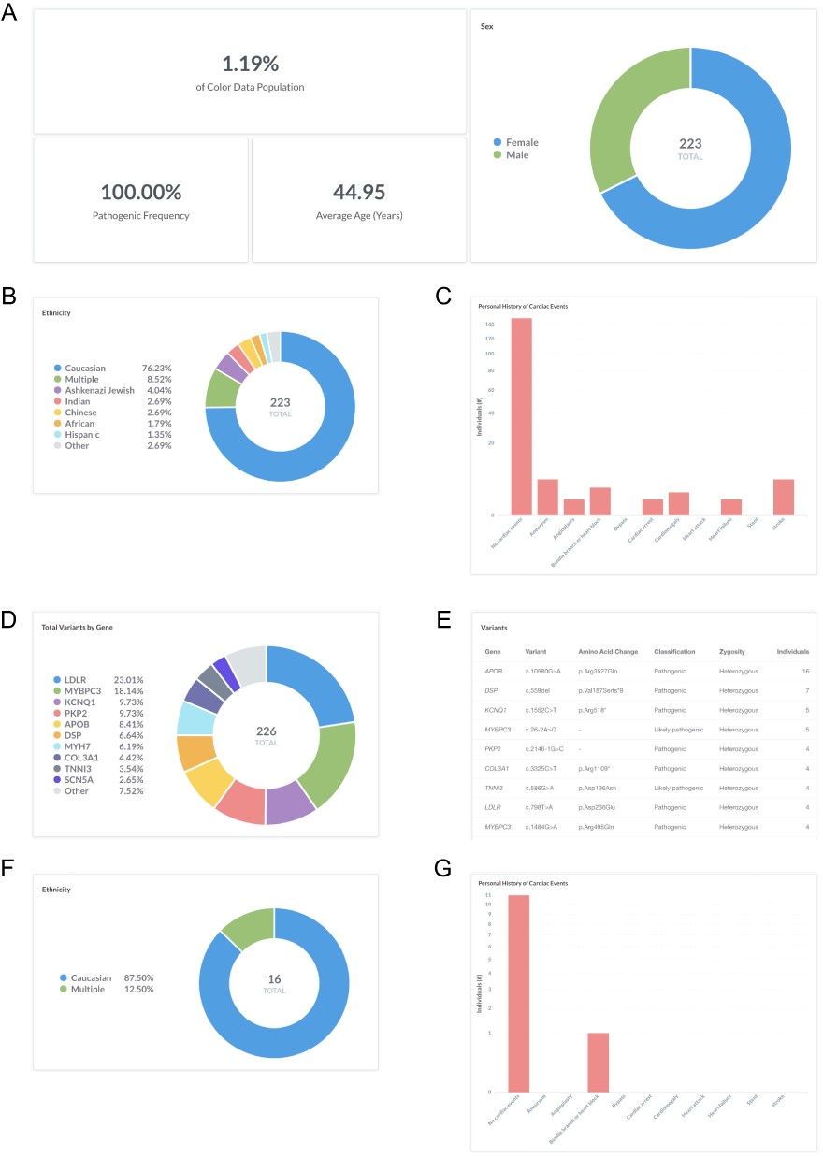
Figure 1. Screenshots of query results for frequency of pathogenic and likely pathogenic variants in genes associated ...
Notes:
Figure 1. Screenshots of query results for frequency of pathogenic and likely pathogenic variants in genes associated with hereditary cardiovascular conditions. (A–E) Filter by ‘Classification: Pathogenic or Likely pathogenic’. Query URL: https://data.color.com/v2/cardio.html#classification=Likely%20pathogenic&classification=Pathogenic (F, G) Remove ‘Classification: Pathogenic or Likely pathogenic’ and filter by ‘Gene: APOB’ and ‘Variant: c.10580G>A’. Query URL: https://data.color.com/v2/cardio.html#gene=APOB&variant=c.10580G%3EA.
Unless provided in the caption above, the following copyright applies to the content of this slide: © The Author(s) 2020. Published by Oxford University Press.This is an Open Access article distributed under the terms of the Creative Commons Attribution License (http://creativecommons.org/licenses/by/4.0/), which permits unrestricted reuse, distribution, and reproduction in any medium, provided the original work is properly cited.

