Slide 1
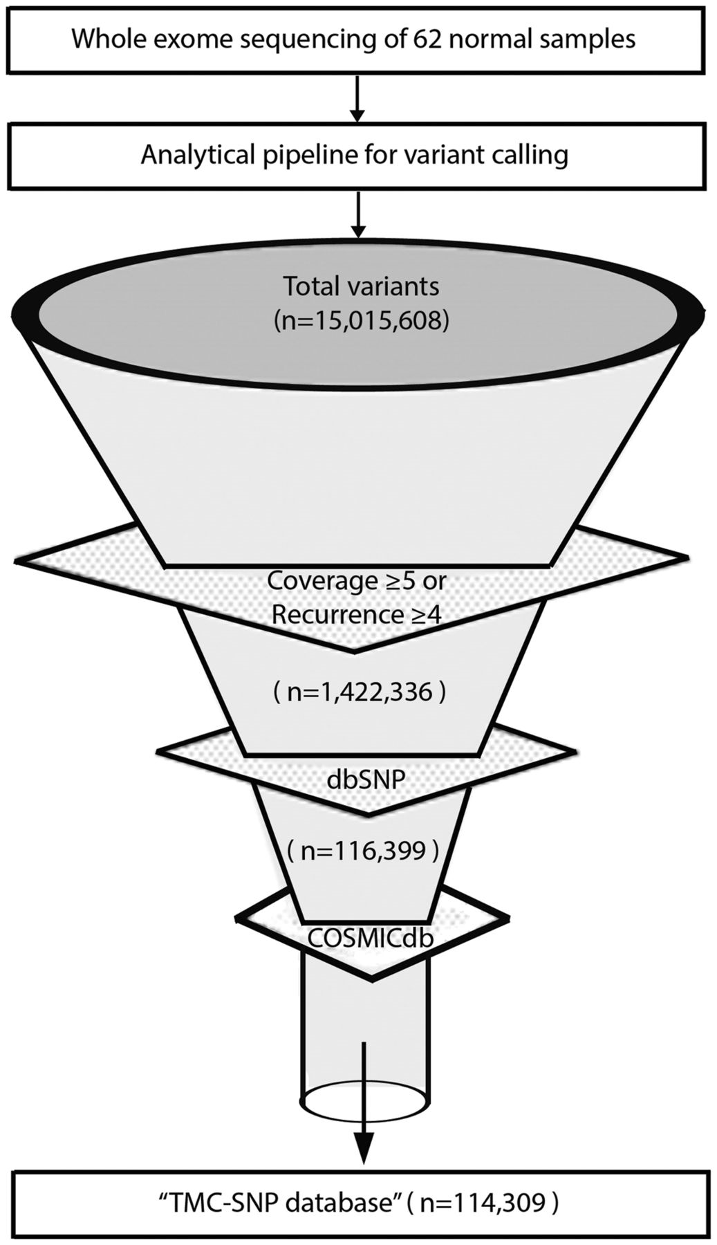
Figure 1. Development of TMC-SNPdb using whole exome sequencing. Schematic flow representation of steps followed during ...
Notes:
Figure 1. Development of TMC-SNPdb using whole exome sequencing. Schematic flow representation of steps followed during development of TMC-SNP database. The whole exome sequencing of 62 normal tissue obtained from three different tissues of cancer patients was performed and analysed using GATK (Genome Analysis Tool Kit) to generate VCF files. Raw variants obtained were further filtered using mentioned criteria to find a list of variants absent in dbSNP v142 and COSMICdb v68. Remaining variants constitutes the ‘TMC-SNPdb’ shown at the end of the funnel.
Unless provided in the caption above, the following copyright applies to the content of this slide: © The Author(s) 2016. Published by Oxford University Press.This is an Open Access article distributed under the terms of the Creative Commons Attribution License (http://creativecommons.org/licenses/by/4.0/), which permits unrestricted reuse, distribution, and reproduction in any medium, provided the original work is properly cited.

