Slide 1
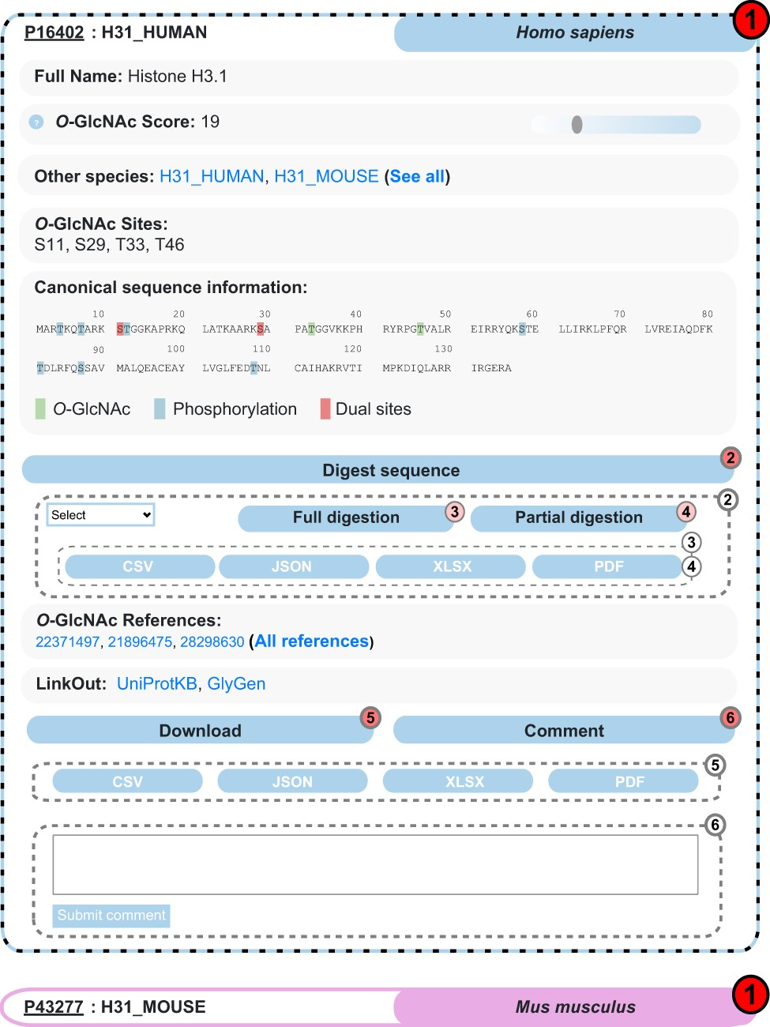
Figure 3. Example of search results for the protein Histone H3.1 in the O-GlcNAc Database. Protein entries are shown as ...
Notes:
Figure 3. Example of search results for the protein Histone H3.1 in the O-GlcNAc Database. Protein entries are shown as collapsible elements (1), and child elements can be accessed on click (dashed frame). Nested collapsible provides digest tools (2) in full (3) and partial (4) modes, download (5) and comment options (6).
Unless provided in the caption above, the following copyright applies to the content of this slide: © The Author(s) 2021. Published by Oxford University Press.This is an Open Access article distributed under the terms of the Creative Commons Attribution License (http://creativecommons.org/licenses/by/4.0/), which permits unrestricted reuse, distribution, and reproduction in any medium, provided the original work is properly cited.

