Slide 1
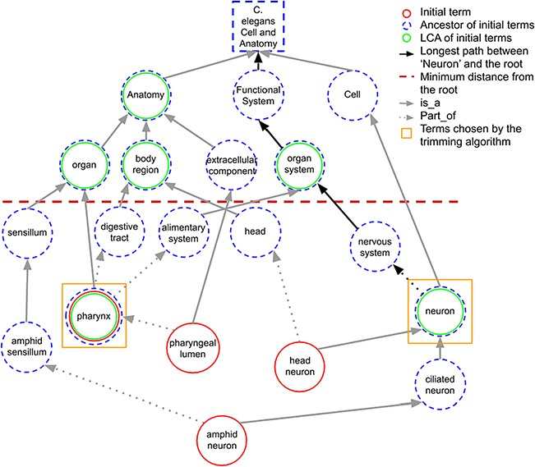
Figure 3 A portion of the C. elegans anatomy ontology graph (generated with the WB SObA tool; 33). Terms circled in ...
Notes:
Figure 3 A portion of the C. elegans anatomy ontology graph (generated with the WB SObA tool; 33). Terms circled in red (single solid circle) represent the initial set of annotated terms for the C. elegans gene abf-1. Dashed blue circles are the ancestors of the initial terms and green circles (double circle) are their respective LCAs in the ontology (excluding the root node). The terms pharynx and neuron (marked by yellow squares) are chosen by the trimming algorithm as they are the only LCAs at the predefined minimum distance from the root (depicted as a dashed horizontal line), which in this example is set to 3. Note that the distance of a term from the root is the length of the longest path between them, which is highlighted in the figure as an example for the term neuron.
Unless provided in the caption above, the following copyright applies to the content of this slide: © The Author(s) 2020. Published by Oxford University Press.This is an Open Access article distributed under the terms of the Creative Commons Attribution License (http://creativecommons.org/licenses/by/4.0/), which permits unrestricted reuse, distribution, and reproduction in any medium, provided the original work is properly cited.

