Slide 1
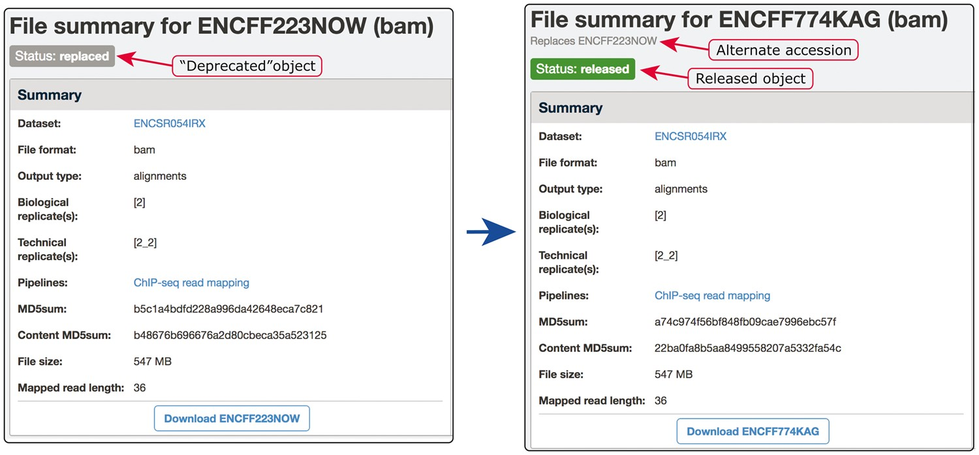
Figure 6. Example of our de-duplication mechanism. BAM files ENCFF223NOW and ENCFF774KAG were found to be data objects ...
Notes:
Figure 6. Example of our de-duplication mechanism. BAM files ENCFF223NOW and ENCFF774KAG were found to be data objects representing the same file. To resolve this situation of file objects duplication, ENCFF223NOW was deprecated (status changed to ‘replaced’) and the accession ENCFF223NOW was added to the list of alternate accessions of the file ENCFF774KAG. Searches for ENCFF223NOW are automatically redirected to the file ENCFF74KAG.
Unless provided in the caption above, the following copyright applies to the content of this slide: © The Author(s) 2018. Published by Oxford University Press.This is an Open Access article distributed under the terms of the Creative Commons Attribution License (http://creativecommons.org/licenses/by/4.0/), which permits unrestricted reuse, distribution, and reproduction in any medium, provided the original work is properly cited.

