Slide 1
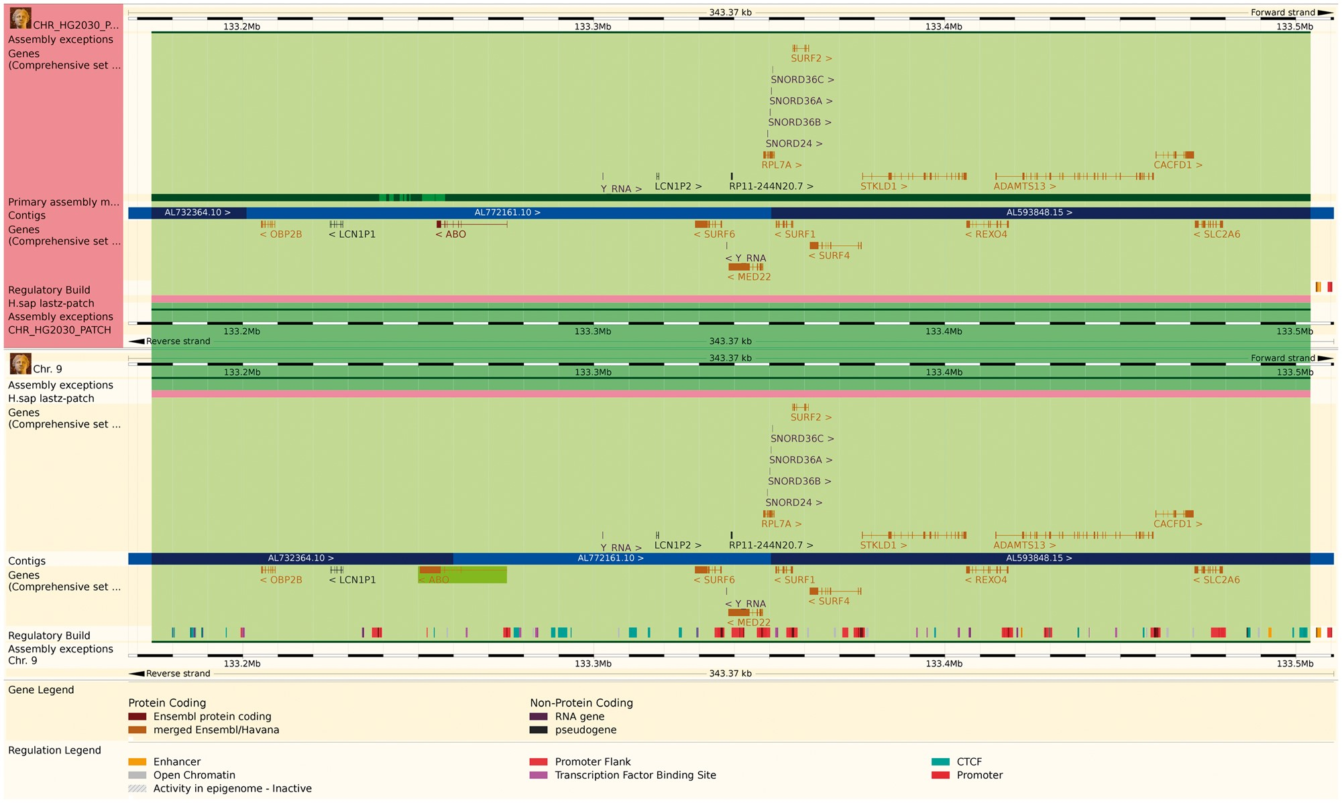
Figure 2. The Ensembl web browser can display the differences between a patch region and its equivalent in the primary ...
Notes:
Figure 2. The Ensembl web browser can display the differences between a patch region and its equivalent in the primary assembly. Genes that are present in both regions are identified as alt_alleles. (http://e87.ensembl.org/Homo_sapiens/Location/Multi?db=core;g=ENSG00000175164;r=CHR_HG2030_PATCH:133174055-133504218;r1=9:133173980-133504143:1;s1=Homo_sapiens–9).
Unless provided in the caption above, the following copyright applies to the content of this slide: © The Author(s) 2017. Published by Oxford University Press.This is an Open Access article distributed under the terms of the Creative Commons Attribution License (http://creativecommons.org/licenses/by/4.0/), which permits unrestricted reuse, distribution, and reproduction in any medium, provided the original work is properly cited.

