Slide 1
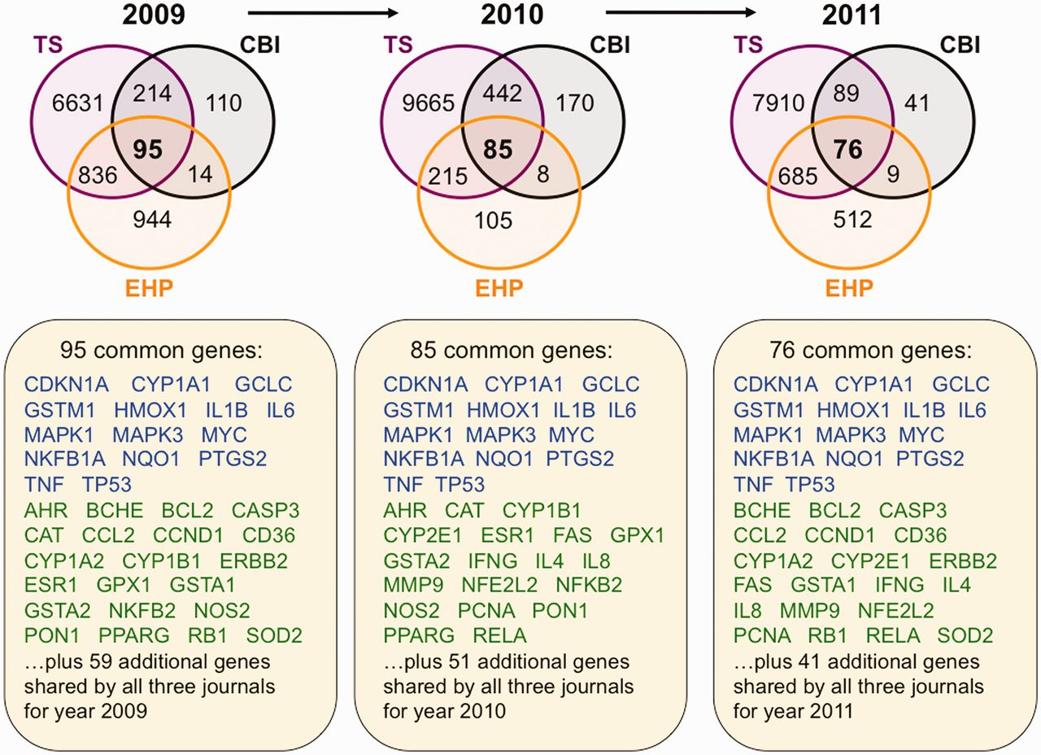
Figure 4 Trending toxicology gene sets from inter-journal comparison. Three Venn diagrams depict the overlapping ...
Notes:
Figure 4 Trending toxicology gene sets from inter-journal comparison. Three Venn diagrams depict the overlapping datasets for curated genes shared by journals TS (purple circles), CBI (black circles) and EHP (orange circles) for years 2009–11. Fifteen genes (blue) are shared by all three journals for all 3 years, and 30 other genes (green) are shared in 2 of the 3 years. The additional genes specific for each individual year are not shown but listed as 59 (for 2009), 51 (for 2010) and 41 (for 2011). All data are provided in the Supplementary Data, and readers can use CTD’s ‘MyVenn’ tool (http://ctdbase.org/tools/myVenn.go) to re-draw the Venn diagrams to explore all the sets.
Unless provided in the caption above, the following copyright applies to the content of this slide: © The Author(s) 2012. Published by Oxford University Press.This is an Open Access article distributed under the terms of the Creative Commons Attribution License (http://creativecommons.org/licenses/by-nc/3.0/), which permits non-commercial reuse, distribution, and reproduction in any medium, provided the original work is properly cited. For commercial re-use, please contact journals.permissions@oup.com.

