Slide 1
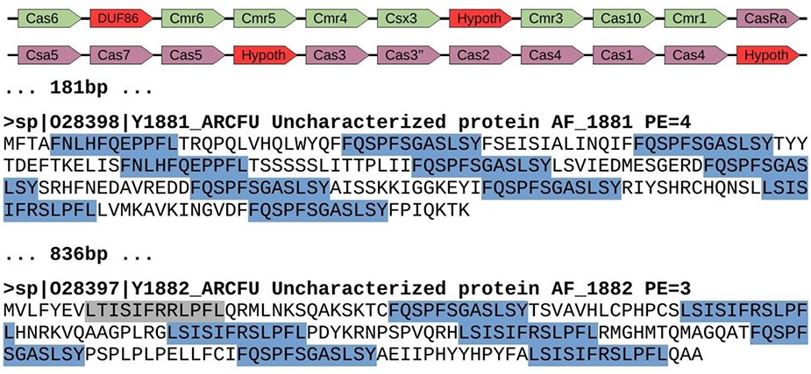
Figure 4. Genomic region of Archaeoglobus fulgidus with several spurious CRISPR sequences (AE000782.1: ...
Notes:
Figure 4. Genomic region of Archaeoglobus fulgidus with several spurious CRISPR sequences (AE000782.1: 1 671 367–1 694 202). This region contains a cluster of cas genes for CRISPR-Cas system class III-B (green color), followed by another cluster of genes for CRISPR-Cas system class I-A (purple color). They appear next to two spurious proteins with repeats arisen from three different reading frames. Red color shows uncharacterized or hypothetical proteins inside the cas clusters. Repeats are highlighted in blue color, with one of them in gray color because it represents a degenerated sequence. The distance between elements is shown in bp, and proteins from Swiss-Prot show the accession number, the identifier, the functional annotation (Uncharacterized protein), the gene name and the protein existence (PE), which represents the evidence that supports the existence of the protein (4 = protein predicted, and 3 = protein inferred from homology).
Unless provided in the caption above, the following copyright applies to the content of this slide: © The Author(s) 2020. Published by Oxford University Press.This is an Open Access article distributed under the terms of the Creative Commons Attribution License (http://creativecommons.org/licenses/by/4.0/), which permits unrestricted reuse, distribution, and reproduction in any medium, provided the original work is properly cited.

