Slide 1
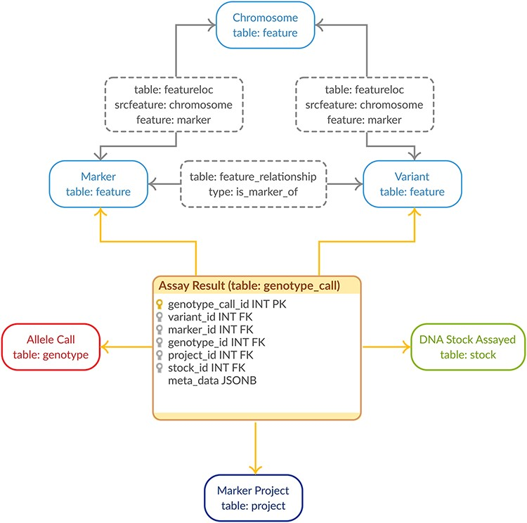
Figure 1. Genotypic Data Model. The entity–relationship diagram describes the relevant sections of the Chado schema for ...
Notes:
Figure 1. Genotypic Data Model. The entity–relationship diagram describes the relevant sections of the Chado schema for storage of genotypic data. The genotype_call table (highlighted in orange) is a backward-compatible enhancement to the Chado schema, whereas all the supporting tables match the generic Chado specification. The genotype_call table gathers together all the metadata for a genotypic data point into a single record through the use of foreign keys.
Unless provided in the caption above, the following copyright applies to the content of this slide: © The Author(s) 2021. Published by Oxford University Press.This is an Open Access article distributed under the terms of the Creative Commons Attribution License (http://creativecommons.org/licenses/by/4.0/), which permits unrestricted reuse, distribution, and reproduction in any medium, provided the original work is properly cited.

Slide 2
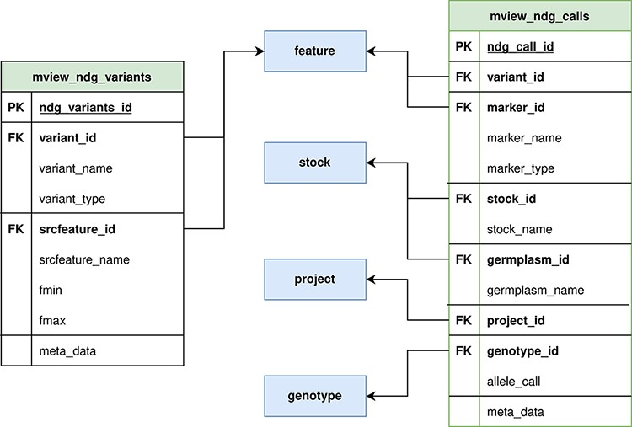
Figure 2. ND Genotypes materialized view implementation. Mview_ndg_variants (left) contains all variant locations ...
Notes:
Figure 2. ND Genotypes materialized view implementation. Mview_ndg_variants (left) contains all variant locations providing support for multiple genome assemblies without duplicating the allele data stored in mview_ndg_calls (right). Both these materialized views pull data from several Chado tables (center, blue) to prevent table joins in user-triggered queries. There are numerous foreign keys in these materialized views to allow retrieval of infrequently required metadata.
Unless provided in the caption above, the following copyright applies to the content of this slide: © The Author(s) 2021. Published by Oxford University Press.This is an Open Access article distributed under the terms of the Creative Commons Attribution License (http://creativecommons.org/licenses/by/4.0/), which permits unrestricted reuse, distribution, and reproduction in any medium, provided the original work is properly cited.

Slide 3
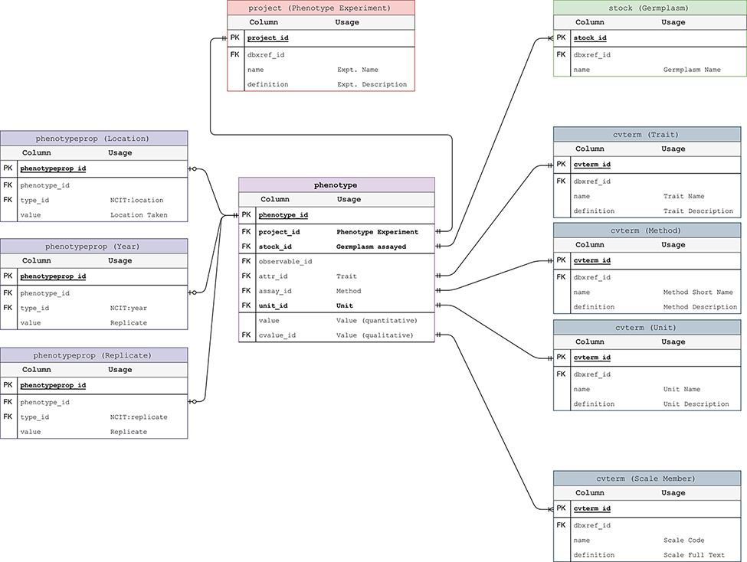
Figure 3. Phenotypic Data Model. The entity–relationship diagram describes the relevant sections of the Chado schema ...
Notes:
Figure 3. Phenotypic Data Model. The entity–relationship diagram describes the relevant sections of the Chado schema for storage of phenotypic data. This data model adheres to the standard Chado schema with the addition of stock, project and unit foreign keys to the phenotype table. The change is backward compatible but critical in that it allows us to store the trait-method-unit tuple in the phenotype table for each phenotypic data point.
Unless provided in the caption above, the following copyright applies to the content of this slide: © The Author(s) 2021. Published by Oxford University Press.This is an Open Access article distributed under the terms of the Creative Commons Attribution License (http://creativecommons.org/licenses/by/4.0/), which permits unrestricted reuse, distribution, and reproduction in any medium, provided the original work is properly cited.

Slide 4
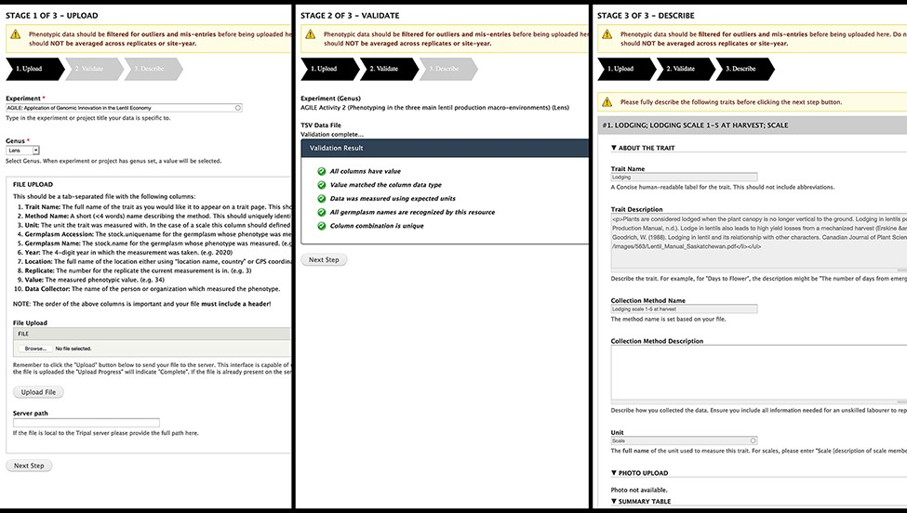
Figure 4. Analyzed Phenotypes Upload form. The left panel shows the first stage of upload, where the user selects their ...
Notes:
Figure 4. Analyzed Phenotypes Upload form. The left panel shows the first stage of upload, where the user selects their experiment and genus and uploads their file in TSV format. Stage 2 (middle) processes the file and reveals green checkmarks where validation has passed and red x’s with helpful guidance if there were errors. The user can re-upload their file if there are issues or move onto the final stage (right) where they will be asked to describe each trait in their file. If a trait name matches exactly to an existing trait in the database, the fields will be gray and cannot be changed as seen in the screenshot but provide a valuable resource for the user to validate that the methods and units used are the same.
Unless provided in the caption above, the following copyright applies to the content of this slide: © The Author(s) 2021. Published by Oxford University Press.This is an Open Access article distributed under the terms of the Creative Commons Attribution License (http://creativecommons.org/licenses/by/4.0/), which permits unrestricted reuse, distribution, and reproduction in any medium, provided the original work is properly cited.

Slide 5
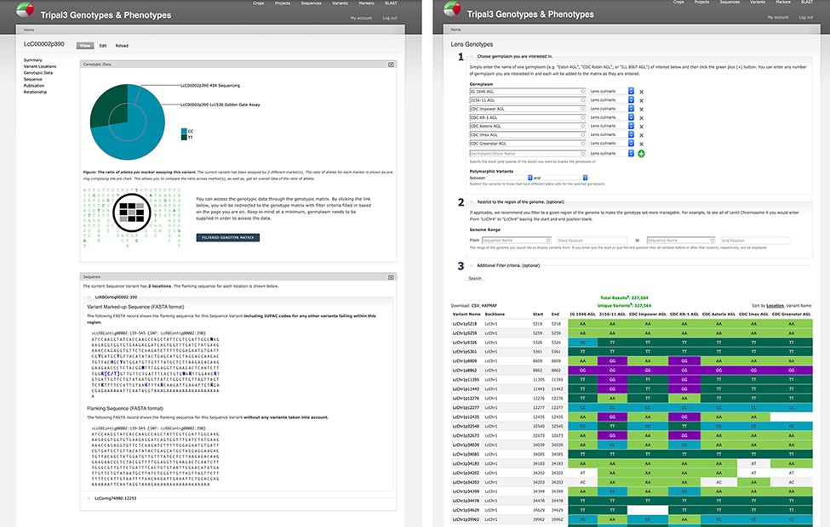
Figure 5. Genotypic data visualization on a generic Tripal site. The left panel shows the distribution of alleles for ...
Notes:
Figure 5. Genotypic data visualization on a generic Tripal site. The left panel shows the distribution of alleles for the current variant as a pie chart (top), a link to the genotype matrix (middle) and the flanking sequence for the variant with known additional variants indicated by their IUPAC codes (bottom). The right panel shows the genotype matrix tool with the allele consensus for seven user-selected germplasm displayed in a variant by germplasm accession table. This table can be further filtered by pairwise polymorphism, genomic region as well as additional filter criteria.
Unless provided in the caption above, the following copyright applies to the content of this slide: © The Author(s) 2021. Published by Oxford University Press.This is an Open Access article distributed under the terms of the Creative Commons Attribution License (http://creativecommons.org/licenses/by/4.0/), which permits unrestricted reuse, distribution, and reproduction in any medium, provided the original work is properly cited.

Slide 6
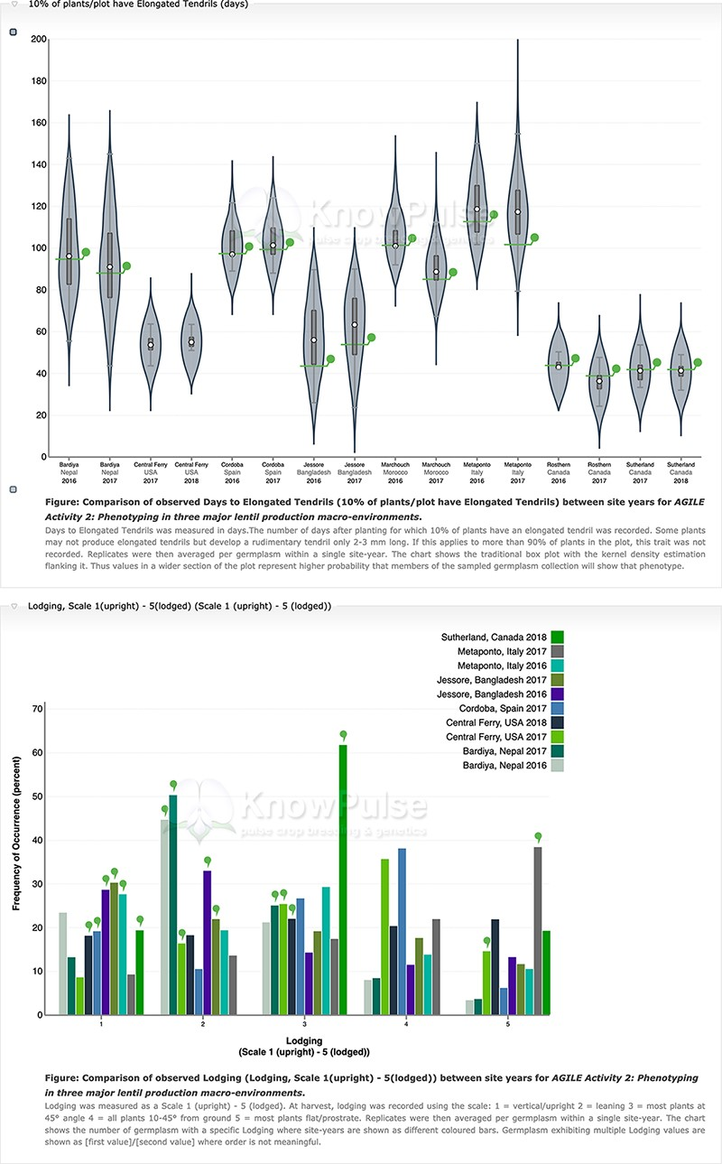
Figure 6. Phenotypic data visualization on a generic Tripal site. Both visualizations are available on specific ...
Notes:
Figure 6. Phenotypic data visualization on a generic Tripal site. Both visualizations are available on specific germplasm pages and show the distribution of phenotypic data collected separated by site-year with the current germplasm indicated by a green indicator. Violin plots (top panel) are used to visualize quantitative data with the mean value shown on the y-axis and the site-year indicated along the x-axis. Histograms (bottom panel) are used to visualize qualitative data with the frequency of occurrence on the y-axis, the scale shown along the x-axis and each site-year indicated by bar color.
Unless provided in the caption above, the following copyright applies to the content of this slide: © The Author(s) 2021. Published by Oxford University Press.This is an Open Access article distributed under the terms of the Creative Commons Attribution License (http://creativecommons.org/licenses/by/4.0/), which permits unrestricted reuse, distribution, and reproduction in any medium, provided the original work is properly cited.

Slide 7
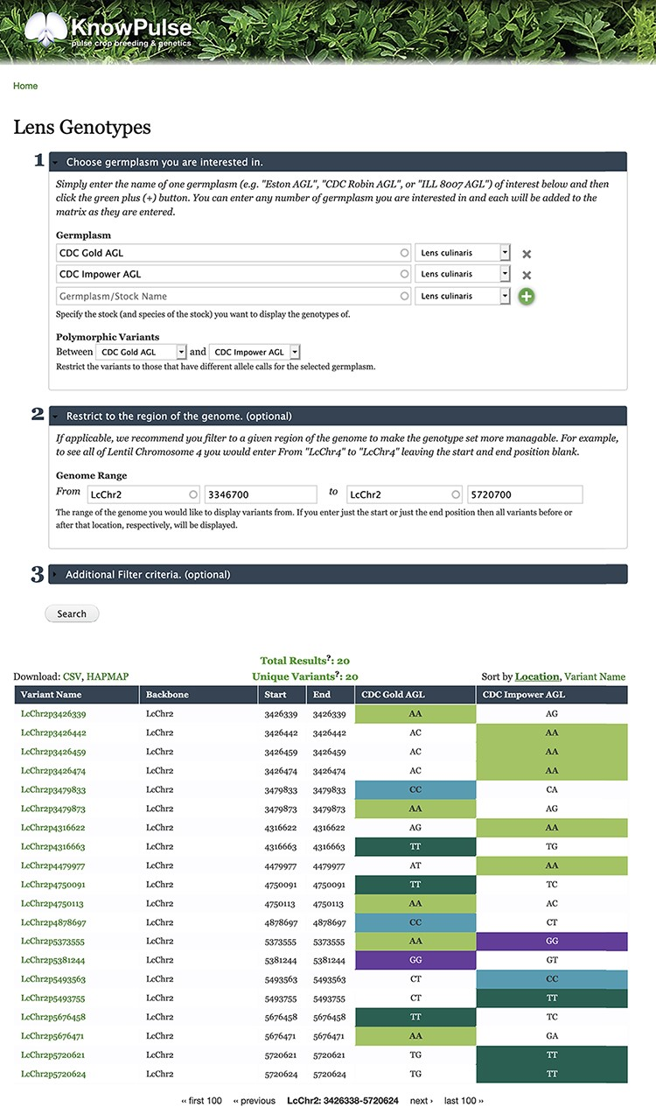
Figure 7. Lentil Genotype Matrix functionality provided by ND Genotypes module. This screenshot shows the listing of ...
Notes:
Figure 7. Lentil Genotype Matrix functionality provided by ND Genotypes module. This screenshot shows the listing of polymorphic genotypic data for CDC Gold AGL and CDC Impower AGL restricted to LcChr2:3346700..5720700. This pre-filtered view can be accessed at https://knowpulse.usask.ca/AGL-Lc1.2-Matrix-Example. Alternatively, the user can access the genotype matrix tool and enter the filter criteria as shown in the screenshot starting with the germplasm names.
Unless provided in the caption above, the following copyright applies to the content of this slide: © The Author(s) 2021. Published by Oxford University Press.This is an Open Access article distributed under the terms of the Creative Commons Attribution License (http://creativecommons.org/licenses/by/4.0/), which permits unrestricted reuse, distribution, and reproduction in any medium, provided the original work is properly cited.

Slide 8
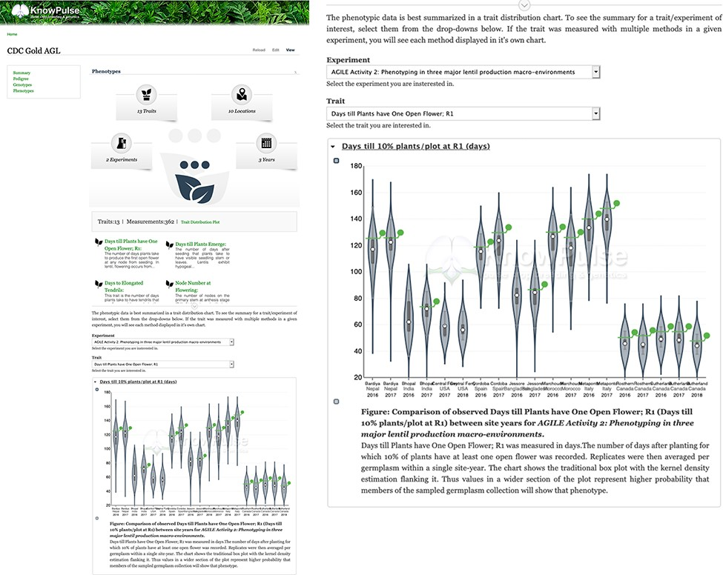
Figure 8. Phenotypic data visualization for CDC Gold AGL provided by Analyzed Phenotypes. The screenshot on the left ...
Notes:
Figure 8. Phenotypic data visualization for CDC Gold AGL provided by Analyzed Phenotypes. The screenshot on the left shows the phenotypic data pane open on the KnowPulse germplasm page for CDC Gold AGL. The top section summarizes the phenotypic data available for CDC Gold AGL, the middle section provides quick links to all traits with data for CDC Gold AGL and the bottom section embeds the ‘Days till 10% of Flowers have one open flower’ Trait Distribution plot for this germplasm. The user selects the trait and experiment combination, and the plot is dynamically drawn for them. The screenshot on the right magnifies the trait distribution plot. This page can be accessed at https://knowpulse.usask.ca/germGoldAgl or by searching for CDC Gold AGL using the Germplasm search tool.
Unless provided in the caption above, the following copyright applies to the content of this slide: © The Author(s) 2021. Published by Oxford University Press.This is an Open Access article distributed under the terms of the Creative Commons Attribution License (http://creativecommons.org/licenses/by/4.0/), which permits unrestricted reuse, distribution, and reproduction in any medium, provided the original work is properly cited.

Slide 9
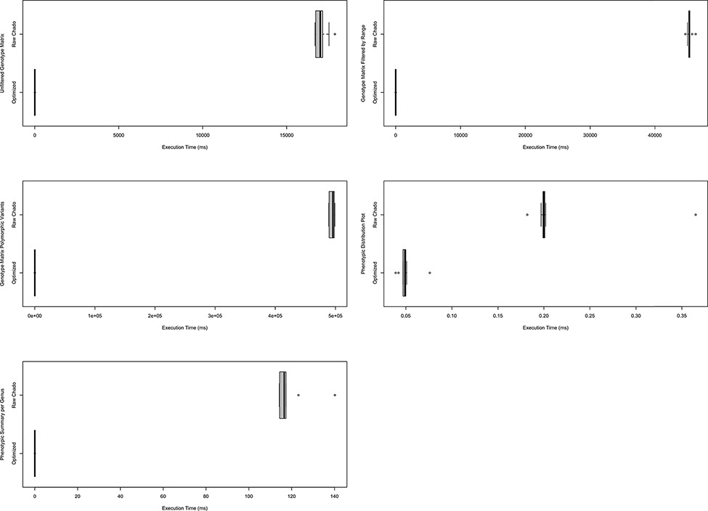
Figure 9. Comparison of timings for functional queries on indexed materialized views versus Chado. The left column ...
Notes:
Figure 9. Comparison of timings for functional queries on indexed materialized views versus Chado. The left column shows timings for genotypic data-focused queries and the right focuses on phenotypic data queries. Each box plot represents functionality in either Analyzed Phenotypes or ND Genotypes with the x-axis indicating the execution time of the query is milliseconds and the y-axis indicating the query performed. All box plots show the optimized form of the query was substantially faster than querying Chado directly. These timings were taken on a production database with nine replicates over the course of 1 day. Queries are fully described in Supplementary Data 1 and methods were described under Systems and Methods: Benchmarking.
Unless provided in the caption above, the following copyright applies to the content of this slide: © The Author(s) 2021. Published by Oxford University Press.This is an Open Access article distributed under the terms of the Creative Commons Attribution License (http://creativecommons.org/licenses/by/4.0/), which permits unrestricted reuse, distribution, and reproduction in any medium, provided the original work is properly cited.

