Slide 1
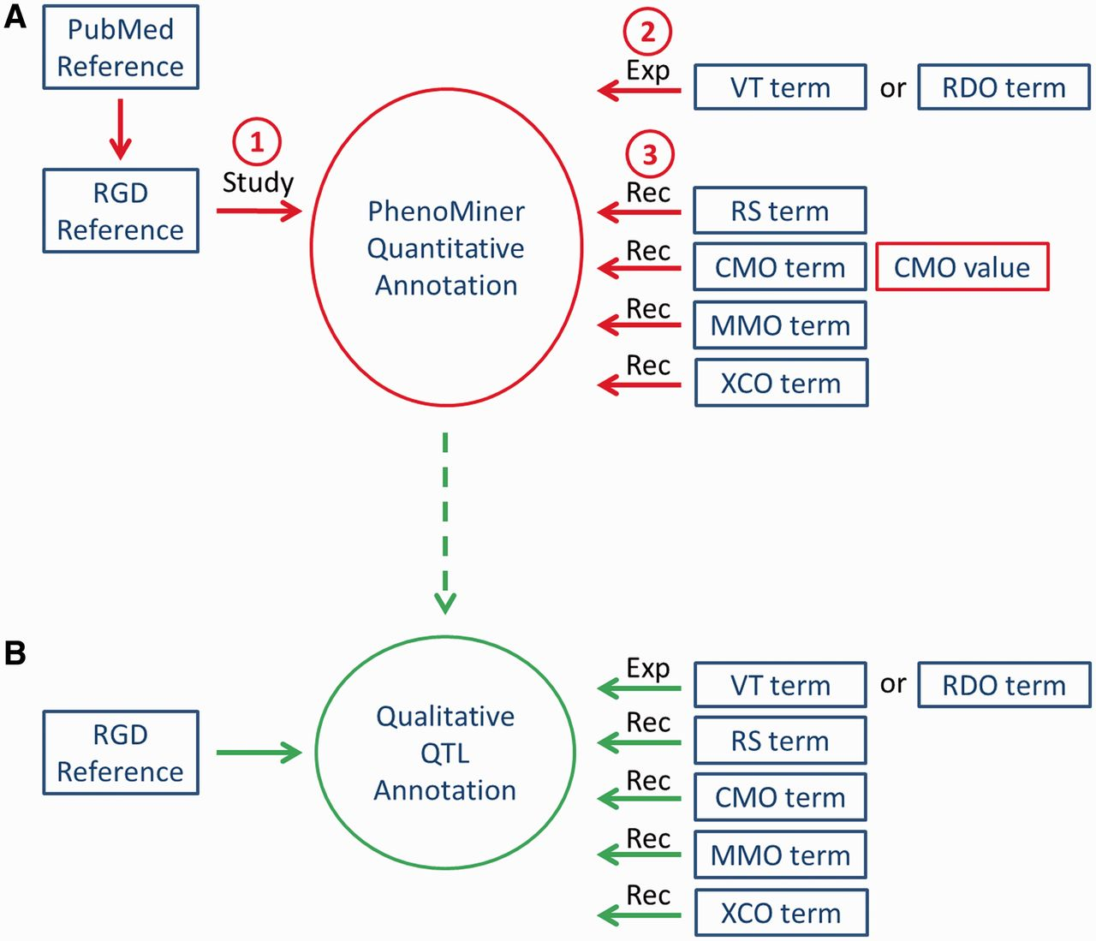
Figure 1 Workflow of PhenoMiner curation. (A) The quantitative PhenoMiner curation workflow showing the sequence that ...
Notes:
Figure 1 Workflow of PhenoMiner curation. (A) The quantitative PhenoMiner curation workflow showing the sequence that establishes first, the ‘Study’, second, the experiment name (Exp) and third, all the details of the annotation ‘Record’ (Rec). (B) Workflow for the new PhenoMiner-style qualitative annotation of QTLs. This workflow uses the same ontologies as the PhenoMiner curation, but uses the general curation tool because no numerical values are entered.
Unless provided in the caption above, the following copyright applies to the content of this slide: © The Author(s) 2013. Published by Oxford University Press.This is an Open Access article distributed under the terms of the Creative Commons Attribution Non-Commercial License (http://creativecommons.org/licenses/by-nc/3.0/), which permits unrestricted non-commercial use, distribution, and reproduction in any medium, provided the original work is properly cited.

