Slide 1
Figure 1. Excerpt from a sample GEO SOFT file.
Notes:
Figure 1. Excerpt from a sample GEO SOFT file.
Unless provided in the caption above, the following copyright applies to the content of this slide: © The Author(s) 2012. Published by Oxford University Press.This is an Open Access article distributed under the terms of the Creative Commons Attribution Non-Commercial License (http://creativecommons.org/licenses/by-nc/3.0), which permits unrestricted non-commercial use, distribution, and reproduction in any medium, provided the original work is properly cited.

Slide 2
Figure 2. Excerpt from a sample MEDLINE citation.
Notes:
Figure 2. Excerpt from a sample MEDLINE citation.
Unless provided in the caption above, the following copyright applies to the content of this slide: © The Author(s) 2012. Published by Oxford University Press.This is an Open Access article distributed under the terms of the Creative Commons Attribution Non-Commercial License (http://creativecommons.org/licenses/by-nc/3.0), which permits unrestricted non-commercial use, distribution, and reproduction in any medium, provided the original work is properly cited.

Slide 3
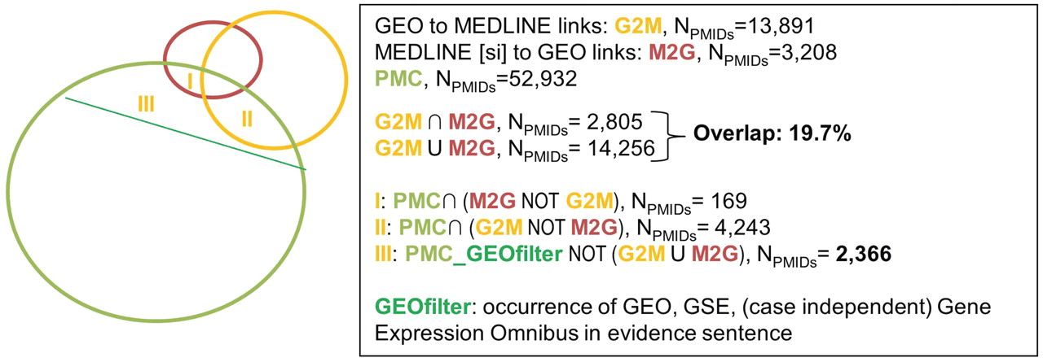
Figure 3. Overlap between GEO, MEDLINE (SI) and the results of text-mining on PMC; evidence statements were extracted ...
Notes:
Figure 3. Overlap between GEO, MEDLINE (SI) and the results of text-mining on PMC; evidence statements were extracted from full-text articles for three categories that were outside the consensus between link sources: (I) Articles curated in MEDLINE but not by GEO, (II) articles curated by GEO but not by MEDLINE and (III) articles curated neither by MEDLINE nor GEO, but identified as relevant for link curation for GEO by our automatic tool.
Unless provided in the caption above, the following copyright applies to the content of this slide: © The Author(s) 2012. Published by Oxford University Press.This is an Open Access article distributed under the terms of the Creative Commons Attribution Non-Commercial License (http://creativecommons.org/licenses/by-nc/3.0), which permits unrestricted non-commercial use, distribution, and reproduction in any medium, provided the original work is properly cited.

Slide 4
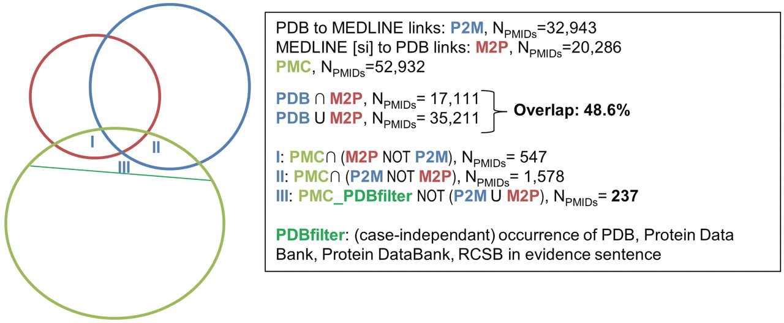
Figure 4. Overlap between PDB, MEDLINE (SI) and the results of text-mining on PMC; evidence statements were extracted ...
Notes:
Figure 4. Overlap between PDB, MEDLINE (SI) and the results of text-mining on PMC; evidence statements were extracted from full-text articles for three categories that were outside the consensus between link sources: (I) Articles curated in MEDLINE but not by PDB, (II) articles curated by PDB but not by MEDLINE and (III) rticles curated neither by MEDLINE nor PDB, but identified as relevant for link curation for PDB by our automatic tool.
Unless provided in the caption above, the following copyright applies to the content of this slide: © The Author(s) 2012. Published by Oxford University Press.This is an Open Access article distributed under the terms of the Creative Commons Attribution Non-Commercial License (http://creativecommons.org/licenses/by-nc/3.0), which permits unrestricted non-commercial use, distribution, and reproduction in any medium, provided the original work is properly cited.

