Slide 1
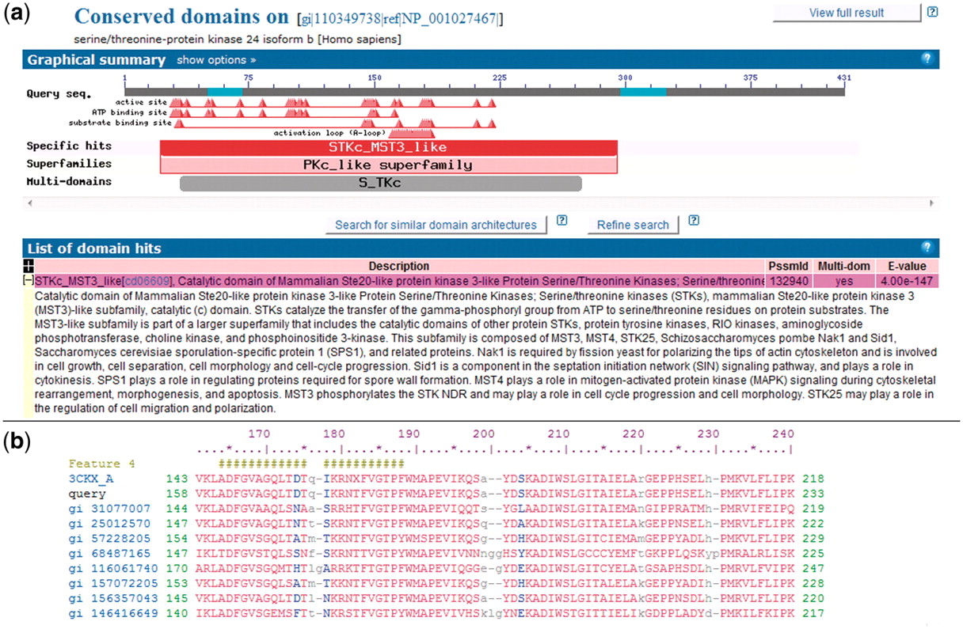
Figure 1. NCBI Conserved Domains annotated on a protein query. (a) RPS-BLAST is used to find domain footprints and ...
Notes:
Figure 1. NCBI Conserved Domains annotated on a protein query. (a) RPS-BLAST is used to find domain footprints and derived functional sites using a serine–threonine protein kinase as a protein query (GI 110349738). Shown in red is a specific hit, i.e. a protein sub-family identified with high confidence. (b) Example of a multiple sequence alignment (MSA) representing a CDD domain. The alignable regions (structured blocks or block alignments) are shown in upper case blocks, while the unaligned regions are shown as lower case and gaps. NCBI CDD also can provide functional site annotation. The hash marks indicate the annotation of an activation loop (A-loop). The row starting with ‘query’ shows the protein query (GI:110349738) with start and stop sites.
Unless provided in the caption above, the following copyright applies to the content of this slide: Published by Oxford University Press 2011.This is Open Access article distributed under the terms of the Creative Commons Attribution Non-Commercial License (http://creativecommons.org/licenses/by-nc/2.5), which permits unrestricted non-commercial use, distribution, and reproduction in any medium, provided the original work is properly cited.

Slide 2
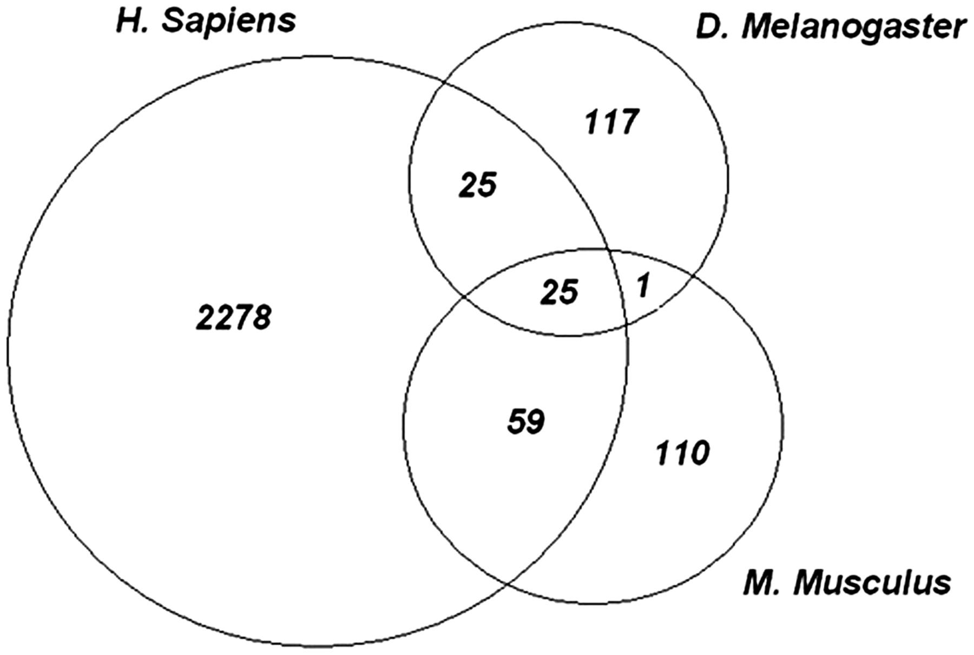
Figure 2. Evolutionarily conserved phosphosites. Each of the experimental phosphopeptide data sets were mapped onto ...
Notes:
Figure 2. Evolutionarily conserved phosphosites. Each of the experimental phosphopeptide data sets were mapped onto conserved domain-specific hits and the site positions on the domain models were examined for overlap. The Venn diagram shows the number of sites that overlap between each species and among all three species. Twenty five highly conserved phosphorylation sites are shared by all species.
Unless provided in the caption above, the following copyright applies to the content of this slide: Published by Oxford University Press 2011.This is Open Access article distributed under the terms of the Creative Commons Attribution Non-Commercial License (http://creativecommons.org/licenses/by-nc/2.5), which permits unrestricted non-commercial use, distribution, and reproduction in any medium, provided the original work is properly cited.

Slide 3
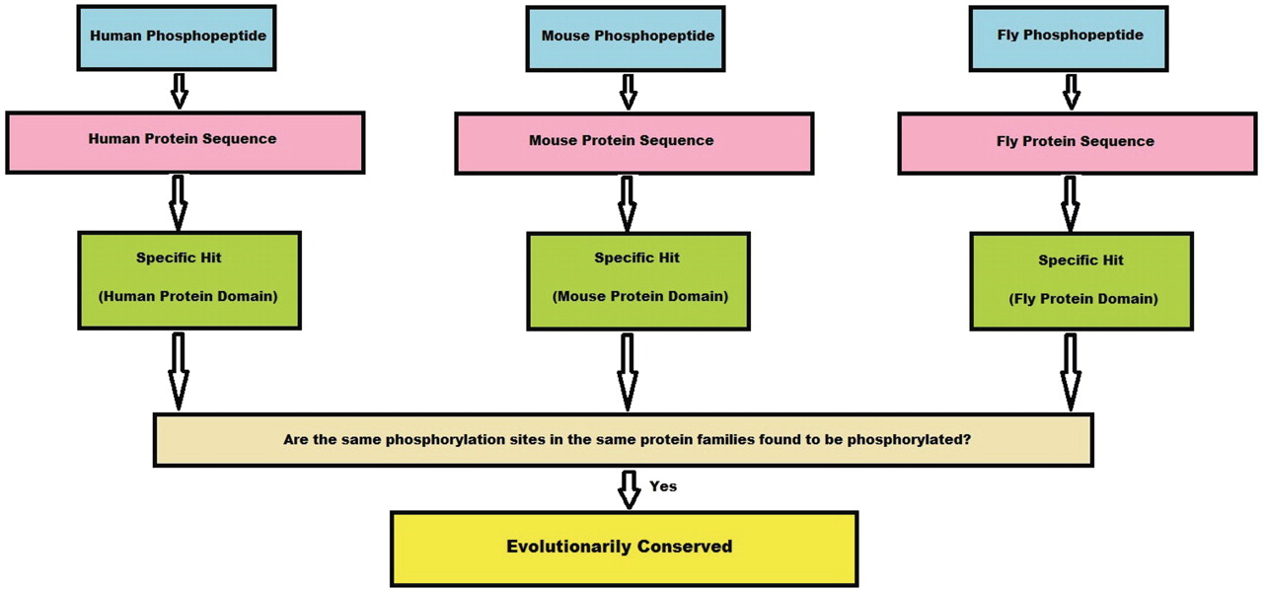
Figure 3. Algorithm flowchart. This flowchart explains in brief how a conserved site is obtained from the experimental ...
Notes:
Figure 3. Algorithm flowchart. This flowchart explains in brief how a conserved site is obtained from the experimental phosphopeptide data sets from three species. First, a phosphopeptide is mapped to its protein sequence and later onto specific hits, if any. If the phosphosites from these three species map to the same position on the specific hit, we consider the site to be conserved.
Unless provided in the caption above, the following copyright applies to the content of this slide: Published by Oxford University Press 2011.This is Open Access article distributed under the terms of the Creative Commons Attribution Non-Commercial License (http://creativecommons.org/licenses/by-nc/2.5), which permits unrestricted non-commercial use, distribution, and reproduction in any medium, provided the original work is properly cited.

