Slide 1
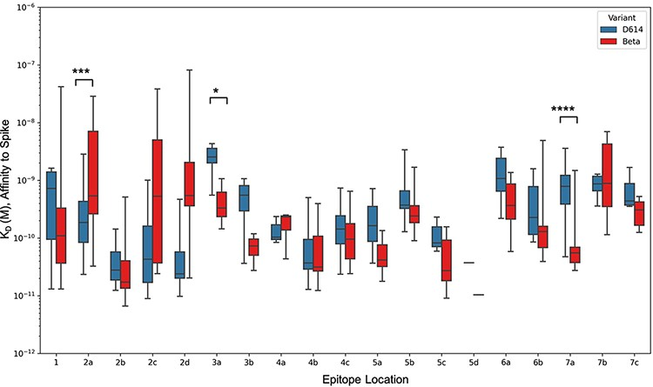
Figure 5. Epitope-wise comparison of antibody binding affinity for Spike D614 (blue bars) and Beta (red bars). ...
Notes:
Figure 5. Epitope-wise comparison of antibody binding affinity for Spike D614 (blue bars) and Beta (red bars). Statistical significances were calculated using Welch’s t-test (****P < 0.0001,*** P < 0.001, **P < 0.01, *P < 0.05). Antibodies are grouped according to the epitope community, and the bars represent the mean binding affinity (note that Community 5d includes only two antibodies).
Unless provided in the caption above, the following copyright applies to the content of this slide: © The Author(s) 2023. Published by Oxford University Press.This is an Open Access article distributed under the terms of the Creative Commons Attribution License (https://creativecommons.org/licenses/by/4.0/), which permits unrestricted reuse, distribution, and reproduction in any medium, provided the original work is properly cited.

