Slide 1
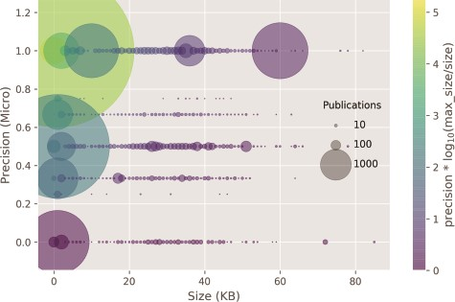
Figure 6 Classifier precision as a function of the publication size. There is no correlation between the size of the ...
Notes:
Figure 6 Classifier precision as a function of the publication size. There is no correlation between the size of the input size and precision. Circle size: number of publications within a size bin. Yellow points: high precision and lower ratio between publication size and the max publication size in the test set. Purple points: low precision and higher ratio between the publication size and the max publication size in the test set.
Unless provided in the caption above, the following copyright applies to the content of this slide: © The Author(s) 2020. Published by Oxford University Press.This is an Open Access article distributed under the terms of the Creative Commons Attribution License (http://creativecommons.org/licenses/by/4.0/), which permits unrestricted reuse, distribution, and reproduction in any medium, provided the original work is properly cited.

