Slide 1
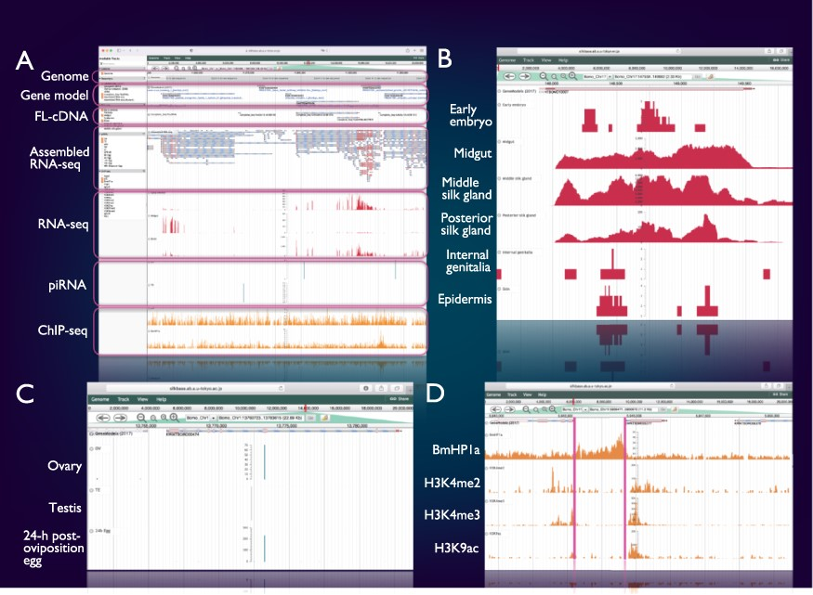
Figure 2. Integrated genome browser. (A) Overview of the genome browser. Genomic, transcriptomic and epigenomic ...
Notes:
Figure 2. Integrated genome browser. (A) Overview of the genome browser. Genomic, transcriptomic and epigenomic information is displayed on a single screen. (B) Transcriptional status of BmSuc1 in different tissues. (C) A piRNA-producing locus in the Masc gene. (D) Histone modifications around the KWMTBOMO06377 gene.
Unless provided in the caption above, the following copyright applies to the content of this slide: © The Author(s) 2022. Published by Oxford University Press.This is an Open Access article distributed under the terms of the Creative Commons Attribution-NonCommercial License (https://creativecommons.org/licenses/by-nc/4.0/), which permits non-commercial re-use, distribution, and reproduction in any medium, provided the original work is properly cited. For commercial re-use, please contact journals.permissions@oup.com

