Slide 1
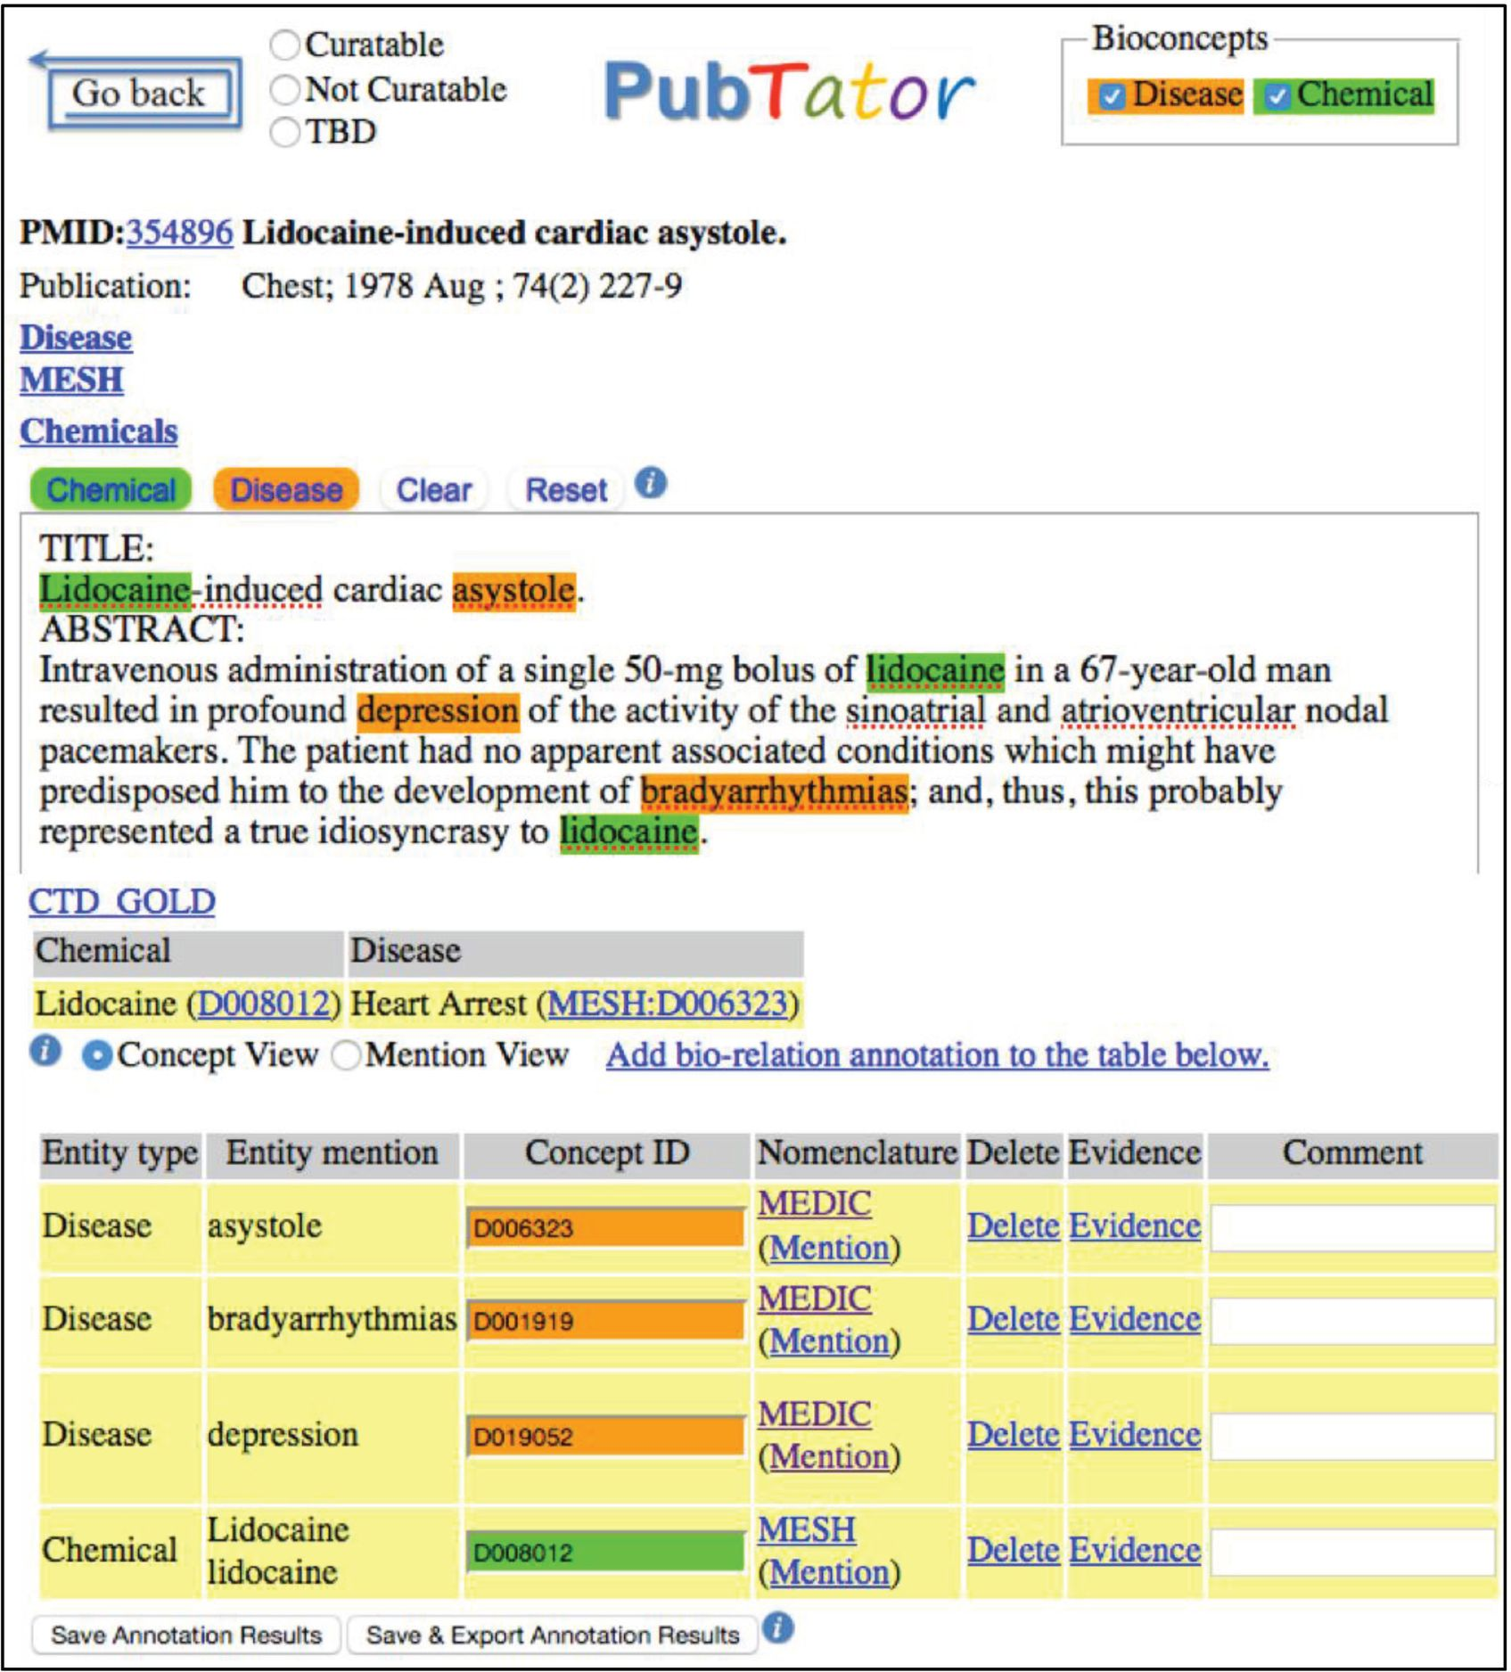
Figure 1. Annotation example shown in our annotation tool, PubTator.
Notes:
Figure 1. Annotation example shown in our annotation tool, PubTator.
Unless provided in the caption above, the following copyright applies to the content of this slide: Published by Oxford University Press 2016. This work is written by US Government employees and is in the public domain in the United States.

