Slide 1
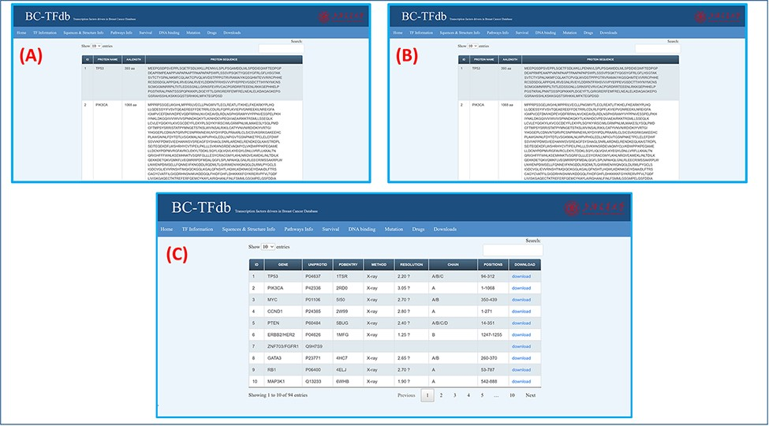
Figure 3. Representation of the Sequence and structural information tab. (A) shows the tutorial image for accessing the ...
Notes:
Figure 3. Representation of the Sequence and structural information tab. (A) shows the tutorial image for accessing the gene sequence information of TFs. (B) shows the tutorial image of accessing the protein sequence information of TFs. (C) shows the tutorial image of accessing the protein structural information of TFs.
Unless provided in the caption above, the following copyright applies to the content of this slide: © Crown copyright 2021.This Open Access article contains public sector information licensed under the Open Government Licence v3.0 (http://www.nationalarchives.gov.uk/doc/open-government-licence/version/3/).

