Slide 1
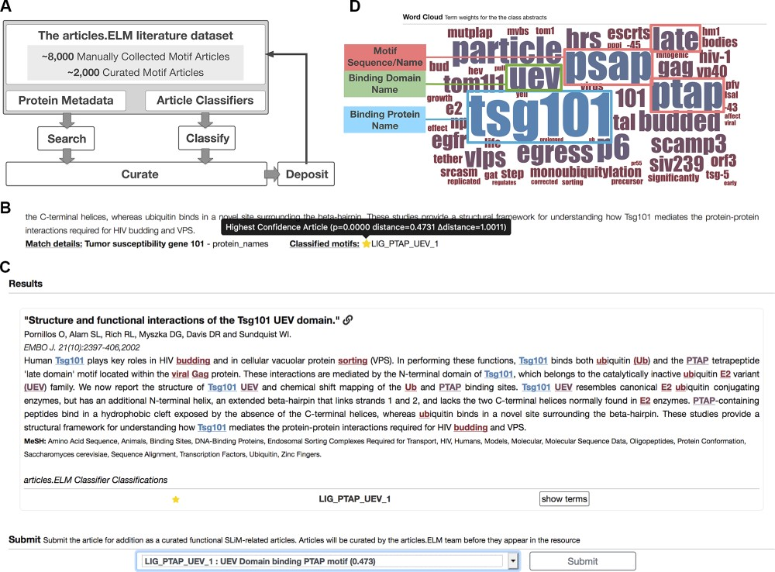
Figure 1 Layout of the articles.ELM resource. (A) Scheme of the articles.ELM framework. (B) Segment of the ...
Notes:
Figure 1 Layout of the articles.ELM resource. (A) Scheme of the articles.ELM framework. (B) Segment of the articles.ELM search page for the search term ‘Tumor susceptibility gene 101’ showing the source of the match as the protein names in the article metadata rather than the article title or abstract. The article also indicates motif classes classified for the article and, if available, any motifs curated in ELM or classified in articles.ELM for the article. (C) Segment of the articles.ELM classify page from the classification of the article titled ‘Structure and functional interactions of the Tsg101 UEV domain’ (11). The output shows the LIG_PTAP_UEV_1 motif class assigned to the article with high confidence (as marked by the full yellow star) and the article abstract is annotated with the key terms for the LIG_PTAP_UEV_1 classification. The terms are coloured by their weight and correspond to the colouring of the logo in the classified page (see panel D). The bottom half of the classify page allows the article to be manually annotated by the user using a list of motif classes and motif groups. (D) Segment of the articles.ELM classified page showing the word cloud representation of the classifier built on the ELM UEV domain-binding PTAP motif (ELM: LIG_PTAP_UEV_1) related articles from the ELM resource. The binding protein (TSG101), binding domain (the UEV domain) and motif sequence/name (PTAP, PSAP or Late domain motif) are highlighted here to demonstrate the relevance of the key terms.
Unless provided in the caption above, the following copyright applies to the content of this slide: © The authors 2020. Published by Oxford University Press on behalf of the Institute of Mathematics and its Applications. All rights reserved.This is an Open Access article distributed under the terms of the Creative Commons Attribution License (http://creativecommons.org/licenses/by/4.0/), which permits unrestricted reuse, distribution, and reproduction in any medium, provided the original work is properly cited.

