Slide 1
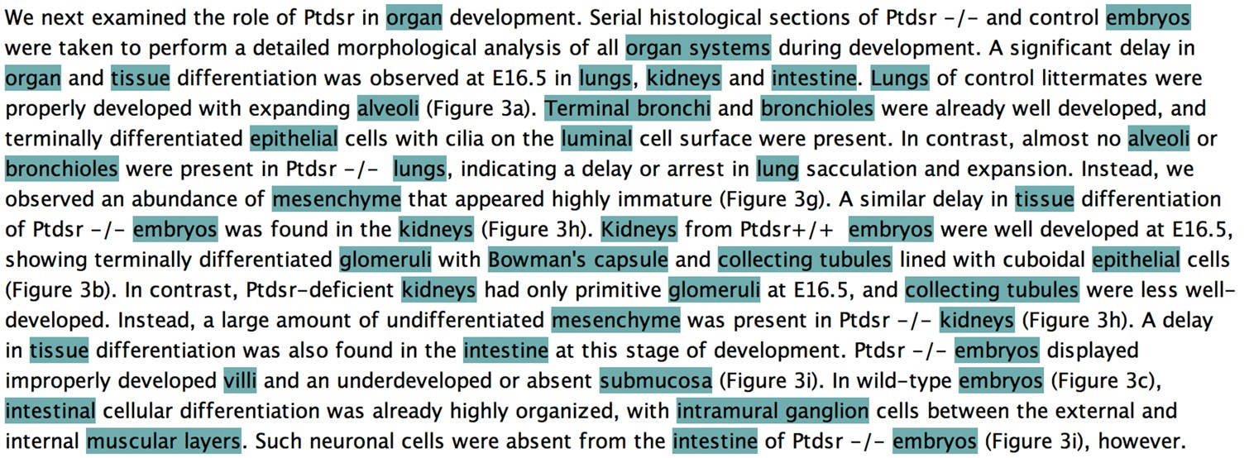
Figure 1. Knowtator screenshot of a paragraph of an article in the public set of the CRAFT Corpus, in which each ...
Notes:
Figure 1. Knowtator screenshot of a paragraph of an article in the public set of the CRAFT Corpus, in which each mention of an anatomical concept explicitly represented in the Uberon ontology has been annotated.
Unless provided in the caption above, the following copyright applies to the content of this slide: © The Author(s) 2017. Published by Oxford University Press.This is an Open Access article distributed under the terms of the Creative Commons Attribution License (http://creativecommons.org/licenses/by/4.0/), which permits unrestricted reuse, distribution, and reproduction in any medium, provided the original work is properly cited.

